Slide 1
IntelliRoast
Chaise Farrar · Drake Bolland JR Jamora · Noah Siano Rebecca Siciliano
Notes:
Chaise
Hello, Thank you for being here today. We are IntelliRoast and we have been graciously sponsored by Kopis Mobile. To begin...

Slide 2
Introduction: Team Members
Chaise Farrar
Computer Engineering
Embedded Design
Team Lead
Drake Bolland
Electrical Engineering
Mechanical Design
Electrical Design
JR Jamora
Electrical Engineering
Thermodynamic Modeling
Electrical Design
Noah Siano
Computer Engineering
Application Development
Website Development
Rebecca Siciliano
Electrical Engineering
Thermodynamic Modeling
Electrical Design
Notes:
Everyone

Slide 3
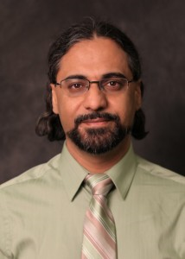
Introduction: Faculty Advisor
Dr. Masoud Karimi
Associate Professor, Mississippi State University
Ph.D., Electrical Engineering, Energy Systems, University of Toronto, Canada, 2004
Power system stability, protection and control
Notes:
Drake
Power system stability, protection and control Power system stability, protection and control Power system stability, protection and control Power system stability, protection and control Power system stability protection and control, Power system stability, protection and control Power system stability, protection and control Power system stability, protection and control Power system stability, protection and control Power system stability, protection and control Power system stability, protection and control, Power system stability, protection and control

Slide 4
Outline
The Problem
The Solution
Constraints
Technical Constraints
Practical Constraints
Engineering Standards
Approach
Problem
Solution
Constraints
Approach
Notes:
JR
Our outline for today is to discuss the problem at hand within the coffee industry and our solution for these problems. We will then discuss how IntelliRoast aims to solve these issues, with an emphasis on our established requirements we are constraining IntelliRoast and the vision set out for IntelliRoast through our approach.

Slide 5
Problem
[1], [2], [3]
Notes:
Chaise
So what is the problem IntelliRoast addresses? It starts with brands like these. They have allowed coffee to become one of the most popular beverages in the world, at a cost. The coffee they provide is low grade, over roasted, and stale, in most cases, by many months. This in contrast to buying coffee from local roasters who provide high quality, fresh roasted coffee. This coffee though comes with a premium price that many can’t justify.

Slide 6
Solution
Notes:
Becca
Roasting your own beans at home is a way of solving this coffee nightmare. By roasting at home, beans are insured to be fresh and roasted to the profile a user wants every time. IntelliRoast is a household kitchen appliance that does just that. It interfaces with an app allowing the user to pick their roasting profile and have a hands free roasting experience at home. To do this we have outlined some constraints on our design.

Slide 7
Technical Constraints
Constraint | Description
Power Draw | Under 15A at 120V
Bean Agitation | Agitate and lift ~120g of beans
Roasting Temperature | At least 300°C
Surface Temperature | Must not exceed 60°C
Wireless Distance | Connect up to 3 meters away [4]
Notes:
Drake

Slide 8
Practical Constraints
Constraint | Description
Economic | Cost less than $500
Hands-Free Usage | Operate without user intervention
App-Enabled | Additional features in smartphone app
Chaff Collection | Collect chaff
Notes:
Noah
IntelliRoast will also need to meet some practical constraints. The device will cost less than $500. There are some similar products already on the market, but those start at $1600, so we wanted to choose a price to allow the everyday consumer to buy this for their home. Also, IntelliRoast will roast coffee without the user having to step in during the process. They just start the roast and IntelliRoast does the rest. This is a key feature, since even the industrial roasters manually control temperatures and roast times for each roast. Additionally, users can use a smartphone app to choose different roasts and view roast progress. Our final practical constraint is chaff collection. Chaff is a paper like substance that flakes off of the coffee beans during the roast, and it is both a nuisance to the consumer and a fire hazard, so IntelliRoast must collect the chaff and keep it separate from the roasted beans.

Slide 9
Engineering Standards
Standard | Description
ASTM C1055 | The surface temperature must be below 70°C
IEC-60529 | Abide by IP ratings to protect against the intrusion of solid objects and water
Notes:
JR
On top of our established constraints, these are the engineering standards IntelliRoast will comply. The ASTM standards establish upper temperature limits where the device transitions from “safe to touch” to “first degree burn risk.” The defined standard is 70 C, which is higher than our established 60 C constraint. This was designed to further protect the user from burns.
The IEC standards define a device’s protection from solid objects and water, which

Slide 10
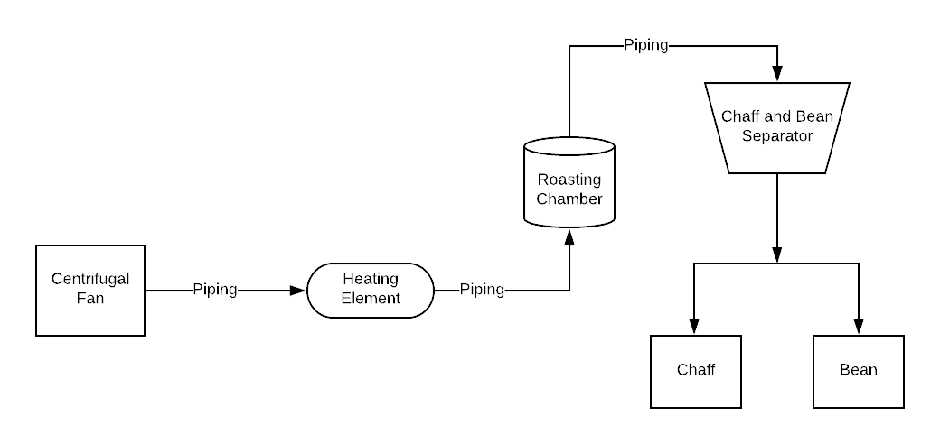
Approach: Mechanical
Notes:
Drake

Slide 11
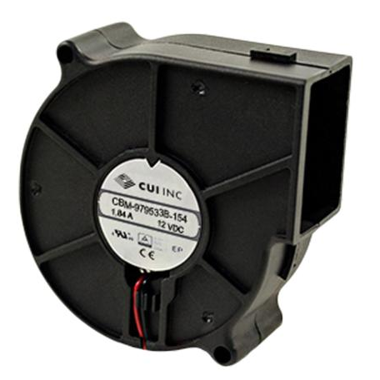
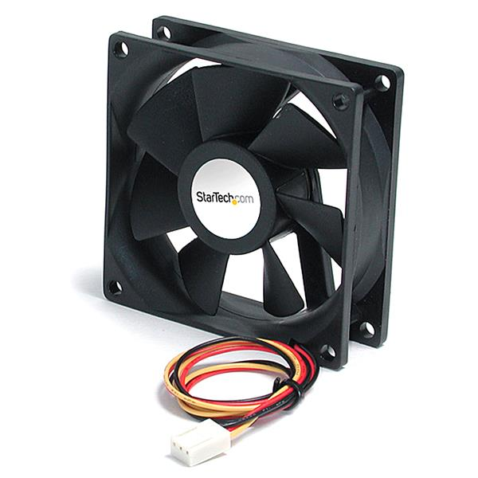
Approach: Fan
Fan S/N | Max Power Input (W) | Max Air Flow (CFM) | Max Static Pressure (inch H₂O) | Price
CBM-979533B-154 | 22.08 | 44.2 | 3.39 | $14.45
CBM-979533B-168 | 48.30 | 54.7 | 5.22 | $18.35
[5], [6]
Notes:
Drake

Slide 12
Approach: Heating Element
Element | Price per Unit (USD) | Description | Properties | Power Rating
REPL Heating Element for HG501A | 28.20 | Heating Element | 500°F~700°F (260°C~371°C) | 1680 W
Custom Resistive Wiring | 21.88/32ft | Nickel Chromium wire only | ~1850°F (~1010°C) | 1000-1100 W
Notes:
Becca
To heat the air moved by the fan and roast the beans, we are using a heating element. We considered two possible ways of heating, custom resistive wiring and a pre-coiled heating element. As you can see, both are well within the 300C constraint. Both are made of nickel chromium which provides an even heat distribution. However, custom wiring would require us to coil the wire ourselves, introducing a lack of uniformity. Conversely, The pre-coiled element is uniform in its coil. The precoilded element also comes with data sheets and information provided. We chose this element despite the higher price since a the greater cost does not hinder our design goals.

Slide 13
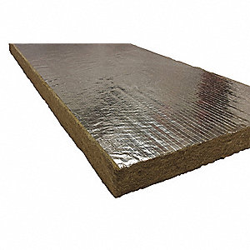
Approach: Insulation
Description | Price (USD) | Primary material | Thickness | R Value
Mineral Wool/Foil Backing High Temperature Insulation | 15.65 | Fiberglass | 1” | 4
Fire Barrier Wrap Strip | 56.09 | Aluminium | 1/8” | 0.005
Fire Barrier Packing Material | 21.11 | Fiberglass | 1/2” | 2
Fiberglass High Temp Tape | 13.10 | Fiberglass | 1/16” | 0.25
[7]
Notes:
JR
“With great heat comes great responsibility”
Two major types of insulation available: Fiberglass, Aluminium-based Fire Barrier Strips
The materials listed here are the different options we considered. The R Value for different products was our deciding factor.
R Value is a measure of how resistant a material is to heat flow, and this is dependent on the thermal conductivity of the material and the thickness of the material.
A higher R Value indicates a material is better suited to resist heat flow.
Based on the higher R value and the price, we selected Mineral Wool/Foil Backing as our insulation material.

Slide 14
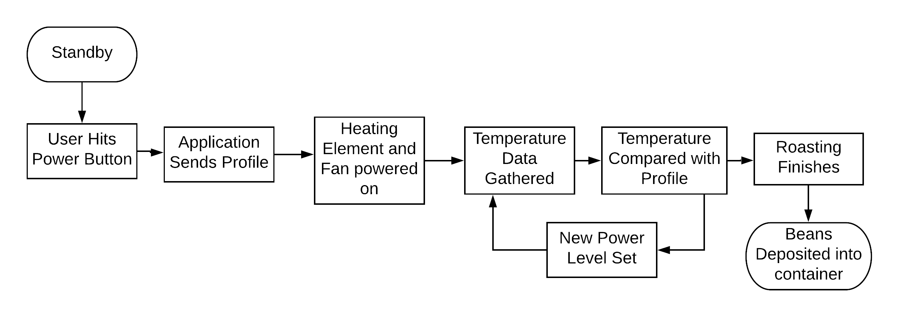
Approach: Control Software
Notes:
Chaise

Slide 15
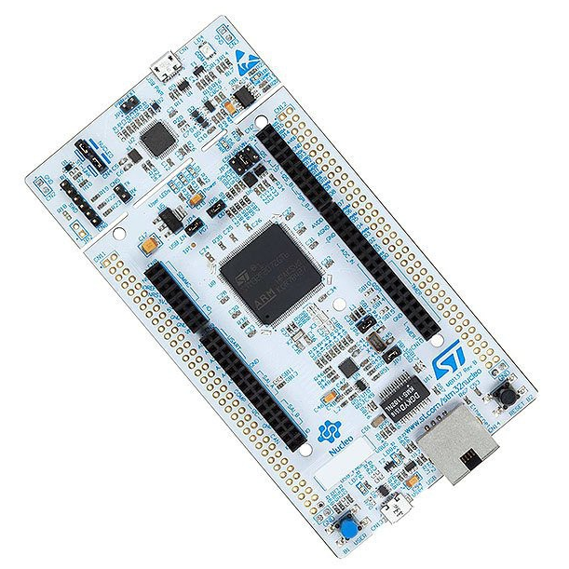
Approach: Microcontroller
Development Board | Clock Speed | SRAM | Flash | GPIO Pins | Price
STMicro Nucleo-F207 | 120MHz | 128KB | 1MB | 140 | $24.47
Arduino Uno | 20MHz | 2KB | 32KB | 23 | $23.38
[8]
Notes:
Chaise

Slide 16
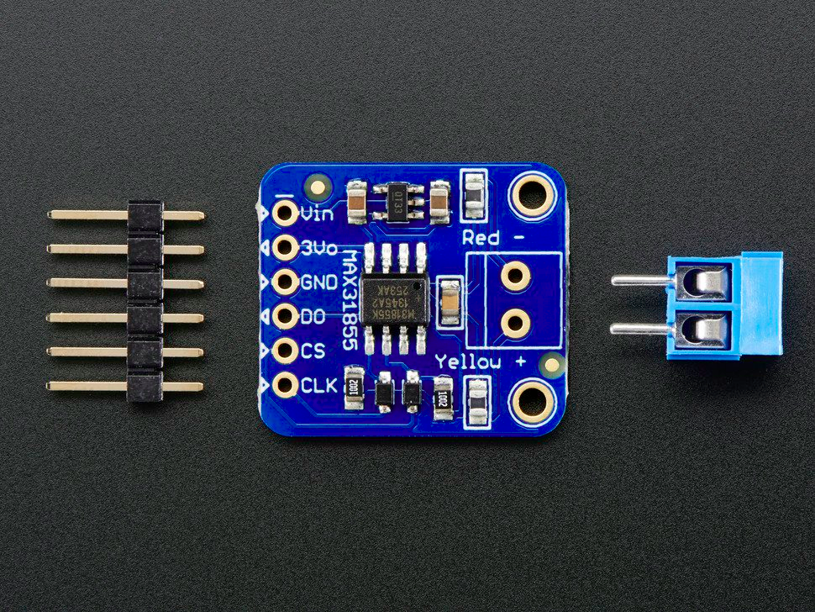
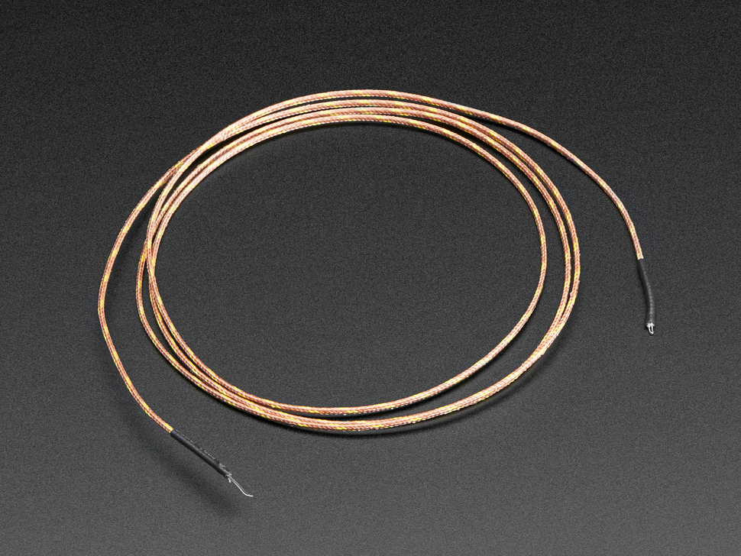
Approach: Temperature Probe
 | Temp Range (°C) | Accuracy | Interface
Requirements | 100°C ~ 300°C | ∓ 5°C | Digital
K-Type Thermocouple + MAX31855 Breakout Board | -200°C ~ 1350°C | ∓ 2°C | SPI
[9], [10]
Notes:
Chaise

Slide 17
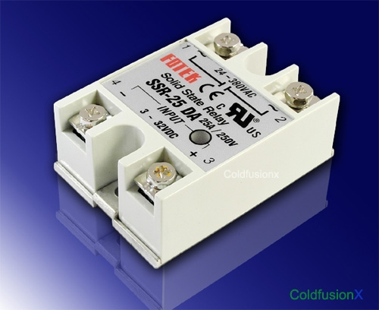
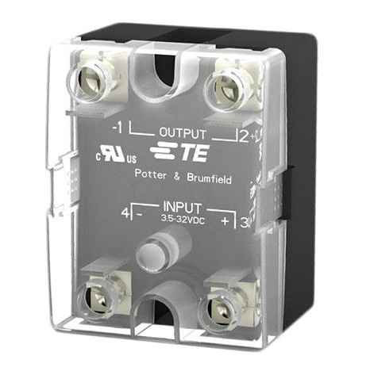
Approach: Solid State Relay
Element | Price per Unit (USD) | Input Rating | Voltage Load Rating | Amperage Load Rating | Response Time (on cycle) | Response Time (off cycle)
Fotek SSR-25DA | $16.50 | 3-32VDC | 24-380VAC | 25A | 10 ms | 10 ms
TE SSRDC-200D12 | $40.06 | 3.5-32VDC | 0-200VAC | 25A | 600 µs | 2.6 ms
[11], [12]
Notes:
Drake

Slide 18
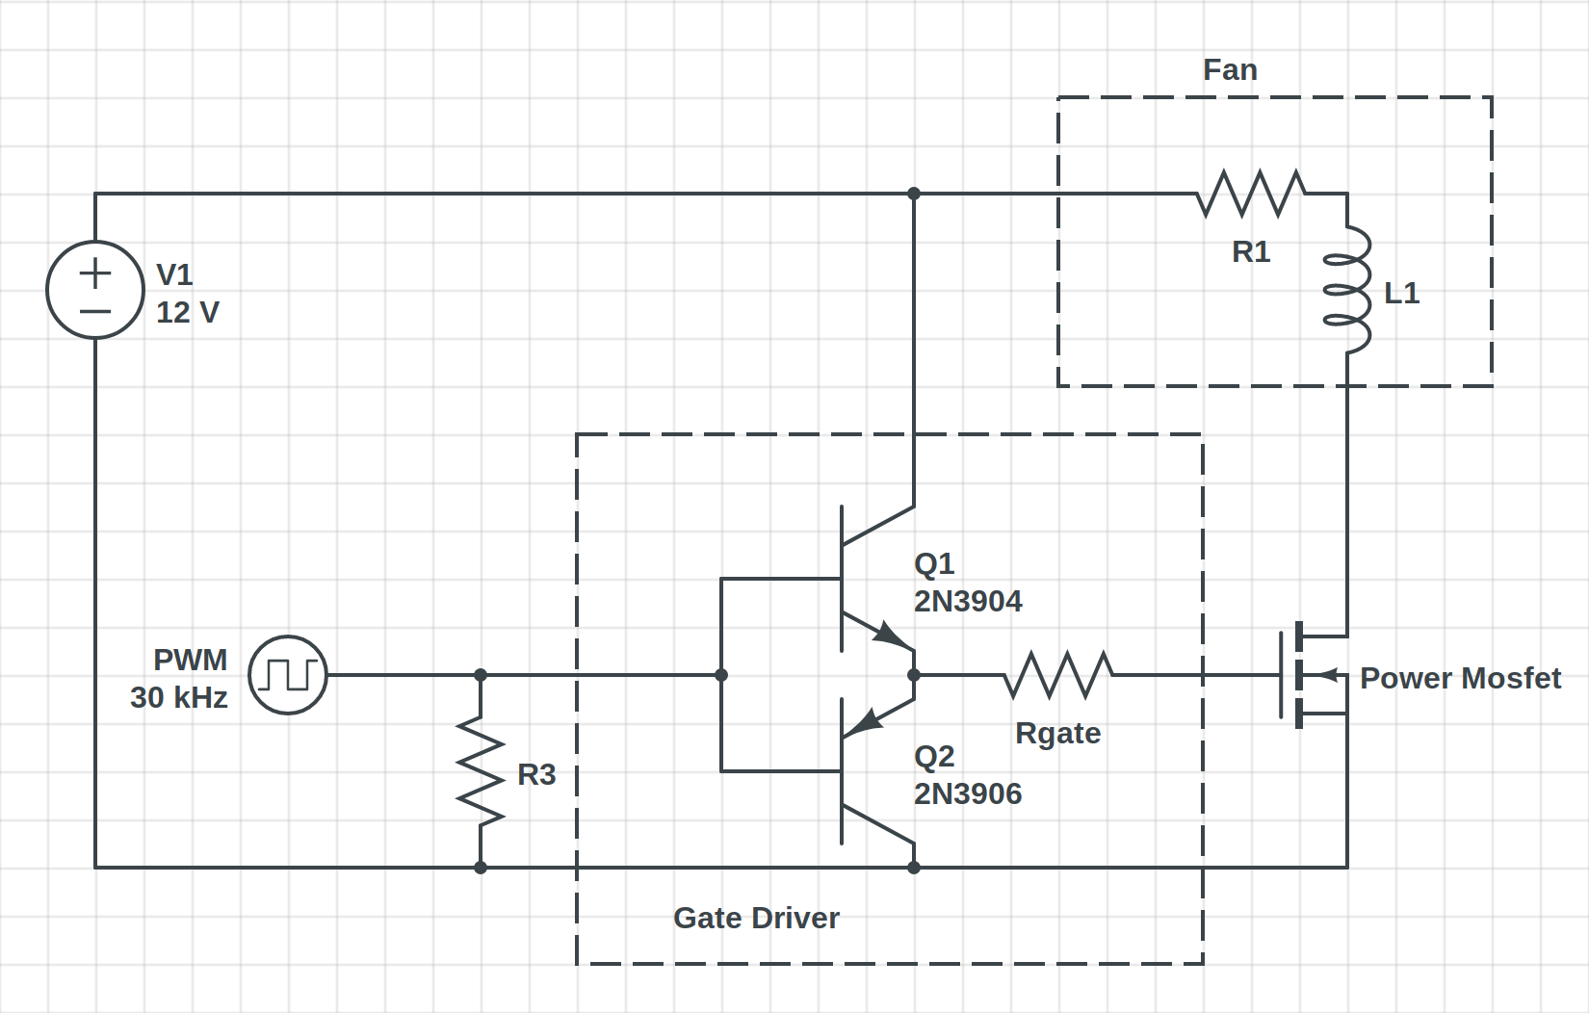
Approach: Fan Controller
Notes:
Becca
To control our fan using pulse width modulation (PWM) we use a high power mosfet to turn on and off the fan rapidly
The gate requires a higher voltage to operate than the microprocessor can supply (3.3-5v)
Using a gate driver, we can use a low voltage to apply a high voltage to the power mosfet, allowing us to turn on and off the fan

Slide 19
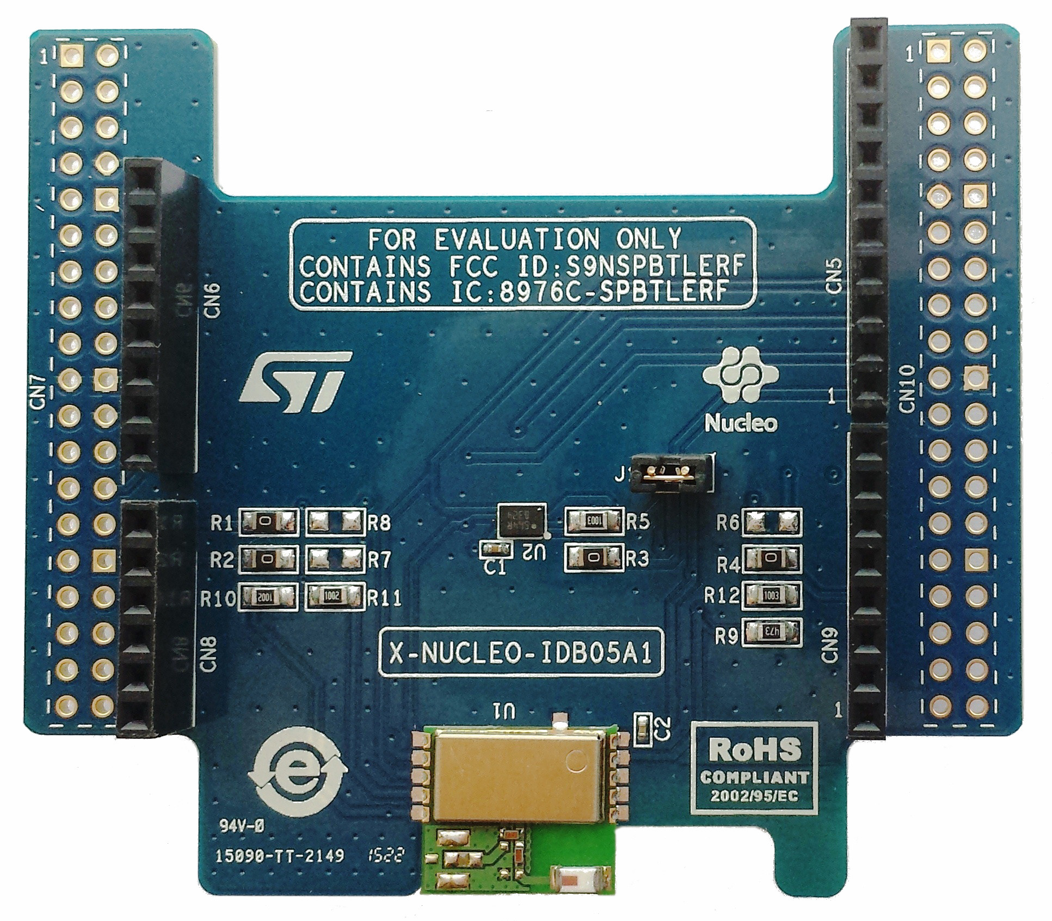
Approach: Bluetooth Module
 | Bluetooth | Range | Libraries
Requirements | BT 4.0 + BLE | 3M | Any
SPBTLE-RF | BT 4.1 + BLE | 50M (Theoretical) | First Party Libs
[13]
Notes:
Chaise

Slide 20
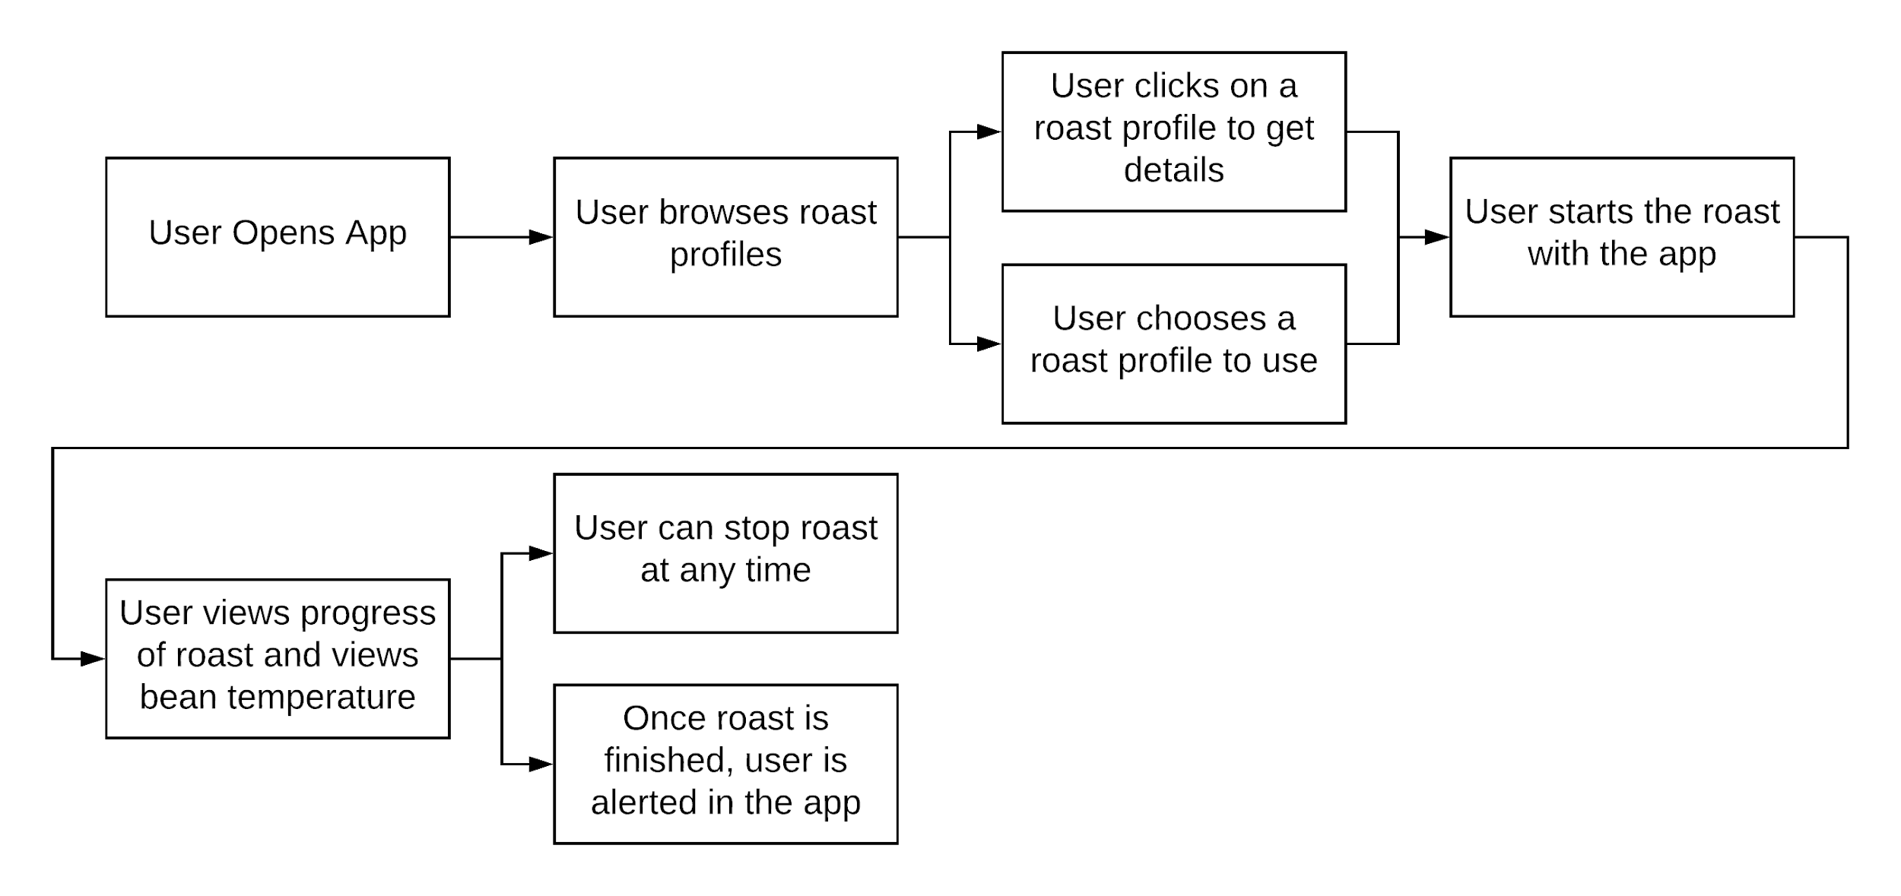
Approach: Smartphone App
Notes:
Smartphone App User Interaction flowchart - Noah

Slide 21
Approach: “Sunny Day” Use Case
Notes:
Drake

Slide 22
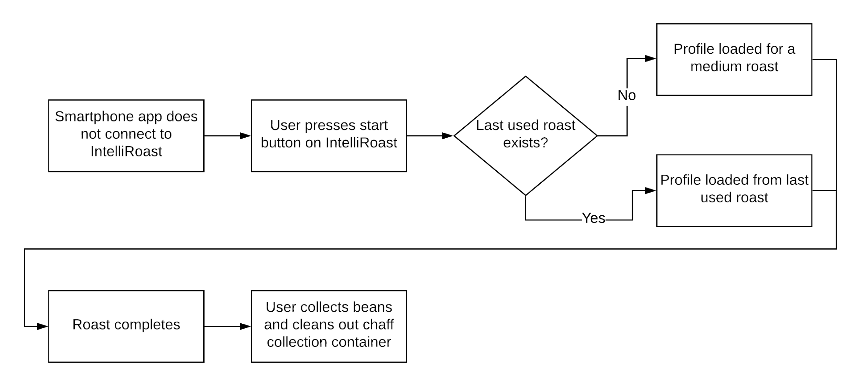
Approach: “Rainy Day” Use Case
Notes:
Noah

Slide 23
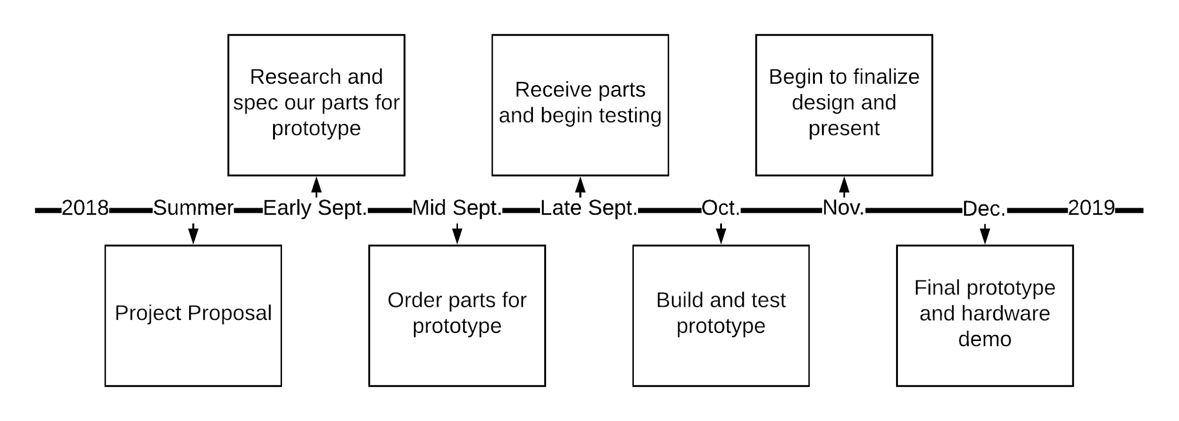
Timeline
Notes:
JR
This timeline shows our progress to this point. We have received all of our parts and have tested our critical parts, such as the fan, heating element, and solid state relays.
Currently, we are building a prototype and are beginning the initial stages of assembly. We anticipate a final prototype by late November or early December.

Slide 24
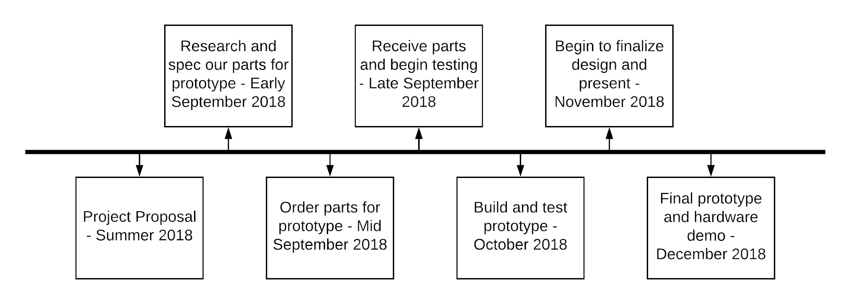
Timeline
Notes:
Drake

Slide 25
References
[1] “Maxwell House,” Recipes. [Online]. Available: http://www.kraftrecipes.com/maxwell-house. [Accessed: 02-Oct-2018].
[2] “Folgers Coffee - The Best Part of Wakin' Up | Folgers Coffee,” History | Folgers Coffee. [Online]. Available: https://www.folgerscoffee.com/. [Accessed: 02-Oct-2018].
[3] “Single Serve Coffee Makers & K-Cup Pods | Keurig®,” Keurig® Coffee Makers | Best Single Cup Coffee Machines. [Online]. Available: https://www.keurig.com/. [Accessed: 02-Oct-2018].
[4] L. Wallender, “Average Kitchen Size? Well, It's Complicated...,” The Spruce. [Online]. Available: https://www.thespruce.com/average-kitchen-size-1822119. [Accessed: 24 Sep. 2018].
[5] Digikey Electronics, “FAN BLOWER 97X33MM 12VDC WIRE,” Digikey Electronics. [Online]. Available: https://www.digikey.com/products/en?keywords=102-4396-ND. [Accessed: 02-Oct-2018]
Notes:
Everyone

Slide 26
References
[6] StarTech Electronics, “92x25mm Ball Bearing Quiet Computer Case Fan w/ TX3 Connector,” StarTech Electronics. [Online]. Available: https://www.startech.com/Computer-Parts/Fans/Quiet-925cm-Dual-Ball-Bearing-Case-Fan-with-TX3-connector~FAN9X25TX3L. [Accessed: 02-Oct-2018].
[7] “1" x 48" x 24" Mineral Wool/Foil Backing High Temperature Insulation, Density 8#, Dark Brown,” Grainger. [Online]. Available: https://www.grainger.com/product/ROXUL-1-x-48-x-24-Mineral-Wool-Foil-19NE81. [Accessed: 02-Oct-2018].
[8] ST Inc, “NUCLEO-F207ZG,” ST. [Online]. Available: https://www.st.com/en/evaluation-tools/nucleo-f207zg.html. [Accessed 02-Oct-2018].
[9] Adafruit Industries, “Thermocouple Amplifier MAX31855 breakout board (MAX6675 upgrade),” Adafruit Industries blog RSS. [Online]. Available: https://www.adafruit.com/product/269. [Accessed: 02-Oct-2018].
[10] Adafruit Industries, “Thermocouple Type-K Glass Braid Insulated - K” Adafruit Industries blog RSS. [Online]. Available: https://www.adafruit.com/product/270. [Accessed: 02-Oct-2018].
Notes:
Everyone

Slide 27
References
[11]“25A Solid State Relay SSR DC In AC Out,” LightObject Laser Cutters and Engravers. [Online]. Available: https://www.lightobject.com/25A-Solid-State-Relay-SSR-DC-In-AC-Out-P61.aspx. [Accessed: 16-Oct-2018].
[12]”SSRDC-200D12,” Digikey. [Online]. Available: https://www.digikey.com/product-detail/en/te-connectivity-potter-brumfield-relays/SSRDC-200D12/PB2566-ND/8612183
[13] ST Inc, “Bluetooth Low Energy expansion board based on SPBTLE-RF module for STM32 Nucleo,” ST. [Online]. Available: https://www.st.com/en/ecosystems/x-nucleo-idb05a1.html. [Accessed” 02-Oct-2018].
Notes:
Everyone

Slide 28
IntelliRoast
Chaise Farrar · Drake Bolland JR Jamora · Noah Siano Rebecca Siciliano
Notes:
Chaise

