Slide 1
IntelliRoast
Chaise Farrar · Drake Bolland JR Jamora · Noah Siano Rebecca Siciliano
Notes:
Chaise
Hello, Thank you for being here today. We are IntelliRoast and we have been graciously sponsored by Kopis Mobile. To begin...

Slide 2
Introduction: Team Members
Chaise Farrar
Computer Engineering
Embedded Design
Team Lead
Drake Bolland
Electrical Engineering
Mechanical Design
Electrical Design
JR Jamora
Electrical Engineering
Thermodynamic Modeling
Electrical Design
Noah Siano
Computer Engineering
Application Development
Website Development
Rebecca Siciliano
Electrical Engineering
Thermodynamic Modeling
Electrical Design
Notes:
Everyone

Slide 3
Introduction: Faculty Advisor
Dr. Masoud Karimi
Associate Professor, Mississippi State University
Ph.D., Electrical Engineering, Energy Systems, University of Toronto, Canada, 2004
Power system stability, protection and control
Notes:
Drake
Power system stability, protection and control Power system stability, protection and control Power system stability, protection and control Power system stability, protection and control Power system stability protection and control, Power system stability, protection and control Power system stability, protection and control Power system stability, protection and control Power system stability, protection and control Power system stability, protection and control Power system stability, protection and control, Power system stability, protection and control

Slide 4
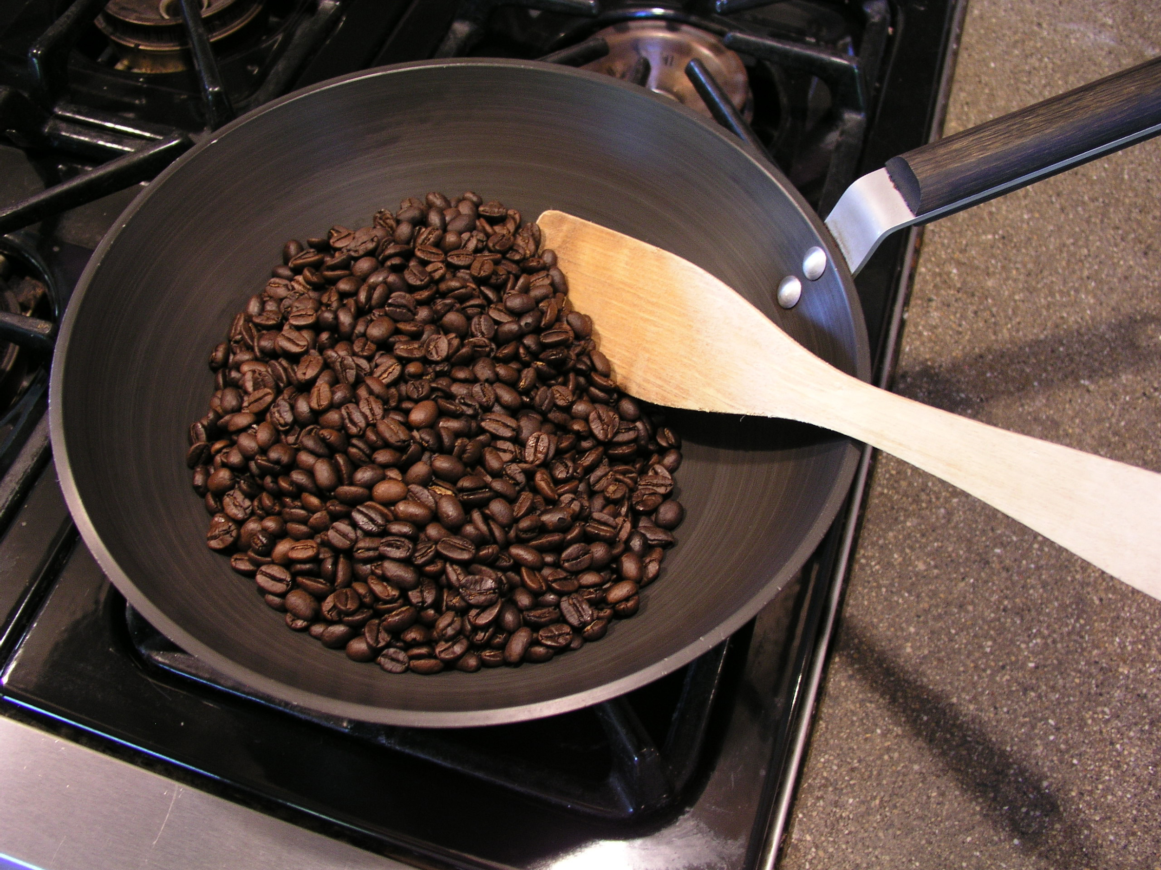
Problem
[1], [2], [3], [4]
Notes:
Chaise
So what is the problem IntelliRoast addresses? It starts with brands like these. They have allowed coffee to become one of the most popular beverages in the world, at a cost. The coffee they provide is low grade, over roasted, and stale, in most cases, by many months. This in contrast to buying coffee from local roasters who provide high quality, fresh roasted coffee. This coffee though comes with a premium price that many can’t justify.

Slide 5
Solution
Notes:
Becca
Roasting your own beans at home is a way of solving this coffee nightmare. By roasting at home, beans are insured to be fresh and roasted to the profile a user wants every time. IntelliRoast is a household kitchen appliance that does just that. It interfaces with an app allowing the user to pick their roasting profile and have a hands free roasting experience at home. To do this we have outlined some constraints on our design.

Slide 6
Technical Constraints
Met? | Constraint | Description
Yes | Power Draw | Under 15A at 120V
Yes | Bean Agitation | Agitate ~120g of beans
Yes | Roasting Temperature | At least 215°C
No* | Surface Temperature | Must not exceed 60°C
Yes | Wireless Distance | Connect up to 3 meters away [5]
Notes:
Drake

Slide 7
Practical Constraints
Met? | Constraint | Description
Yes | Economic | Cost less than $500
Yes | Hands-Free Usage | Operate without user intervention
Yes | App-Enabled | Additional features in smartphone app
Yes | Chaff Collection | Collect chaff
Notes:
Noah
IntelliRoast will also need to meet some practical constraints. The device will cost less than $500. There are some similar products already on the market, but those start at $1600, so we wanted to choose a price to allow the everyday consumer to buy this for their home. Also, IntelliRoast will roast coffee without the user having to step in during the process. They just start the roast and IntelliRoast does the rest. This is a key feature, since even the industrial roasters manually control temperatures and roast times for each roast. Additionally, users can use a smartphone app to choose different roasts and view roast progress. Our final practical constraint is chaff collection. Chaff is a paper like substance that flakes off of the coffee beans during the roast, and it is both a nuisance to the consumer and a fire hazard, so IntelliRoast must collect the chaff and keep it separate from the roasted beans.

Slide 8
Engineering Standards
Standard | Description
ASTM C1055 | The surface temperature must be below 70°C
IEC-60529 | Abide by IP ratings to protect against the intrusion of solid objects and water
Notes:
JR
On top of our established constraints, these are the engineering standards IntelliRoast will comply. The ASTM standards establish upper temperature limits where the device transitions from “safe to touch” to “first degree burn risk.” The defined standard is 70 C, which is higher than our established 60 C constraint. This was designed to further protect the user from burns.
The IEC standards define a device’s protection from solid objects and water, which

Slide 9
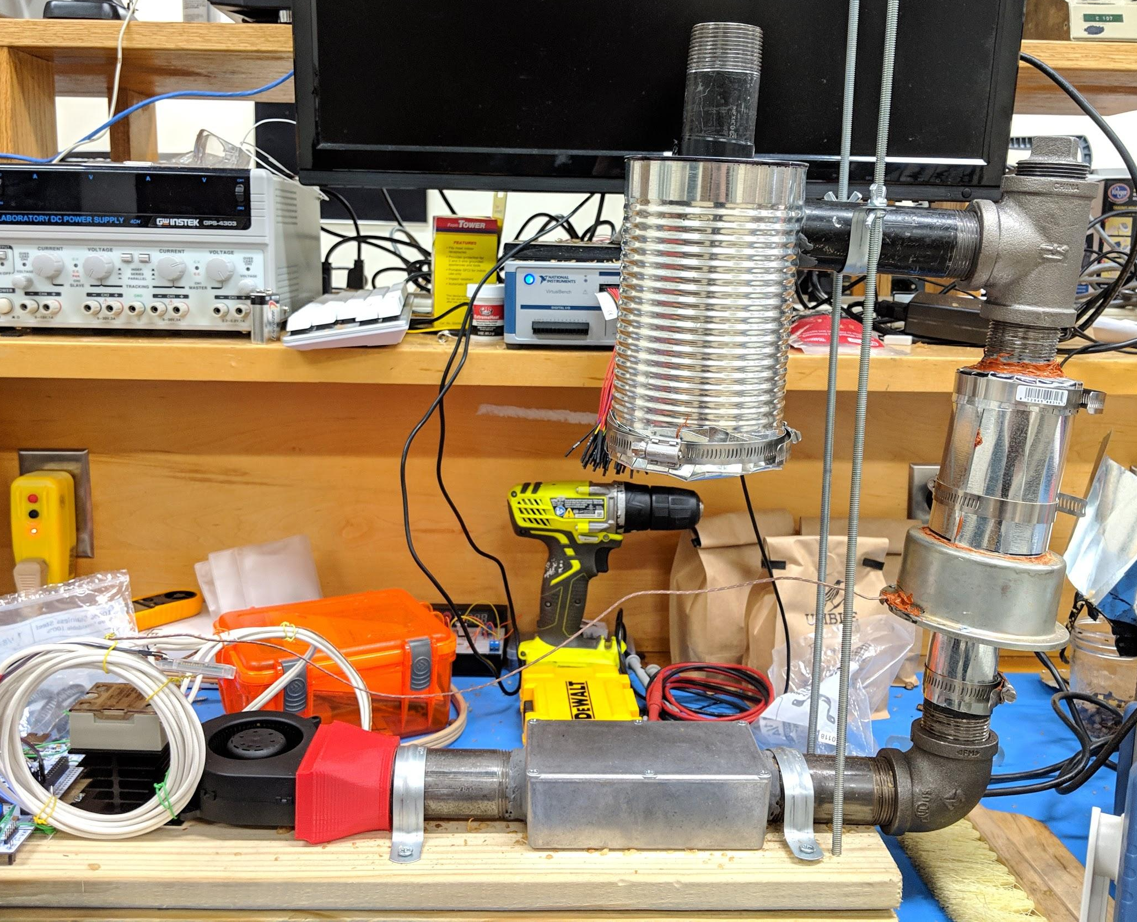
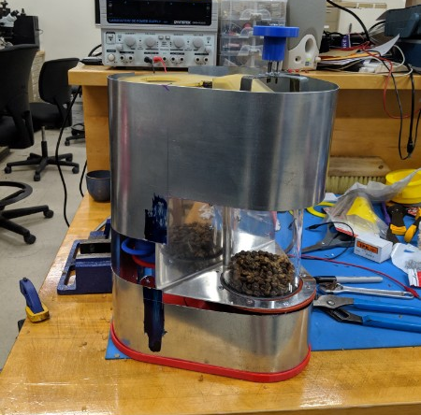
Prototype Overview
Design 1 Prototype
Design 2 Prototype
Notes:
Drake

Slide 10
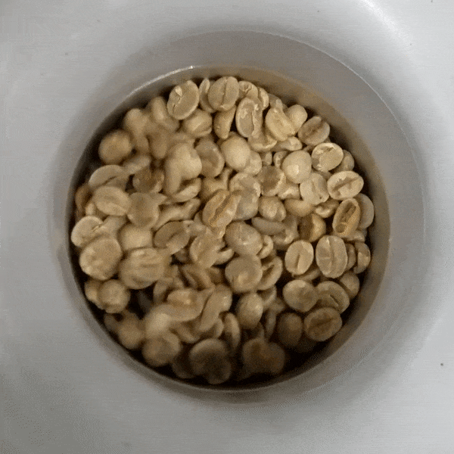
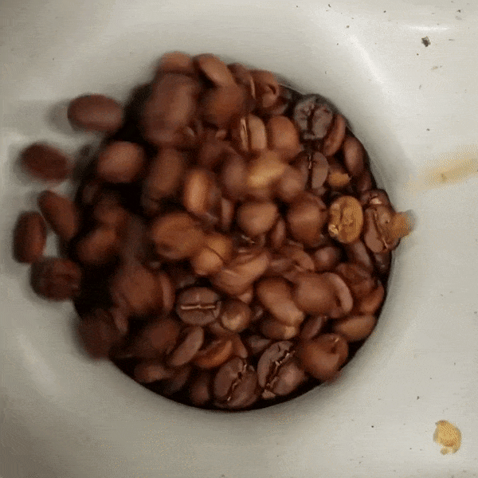
Bean Agitation
Notes:
Chaise

Slide 11
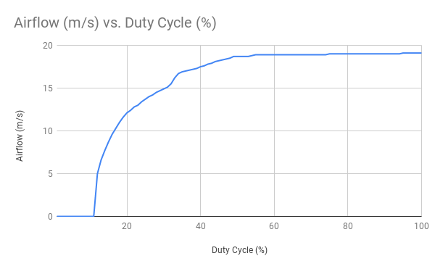
Bean Agitation (cont.)
Duty Cycle (%) | Bean Agitation
15 | No
25 | Minor
30 | Moderate
35 | Yes
Notes:
Chaise

Slide 12
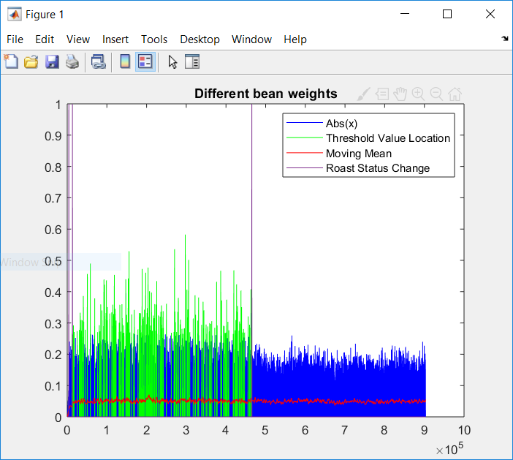
Bean Agitation (cont.)
Bean Agitation Sensing
Standard microfet paired with an amplifier
Using an algorithm designed by JR Jamora
Can detect sufficient agitation and signal when Agitation stops.
Notes:
Chaise

Slide 13
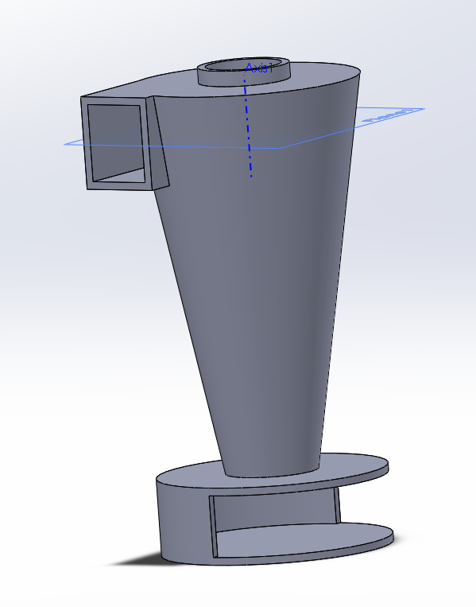
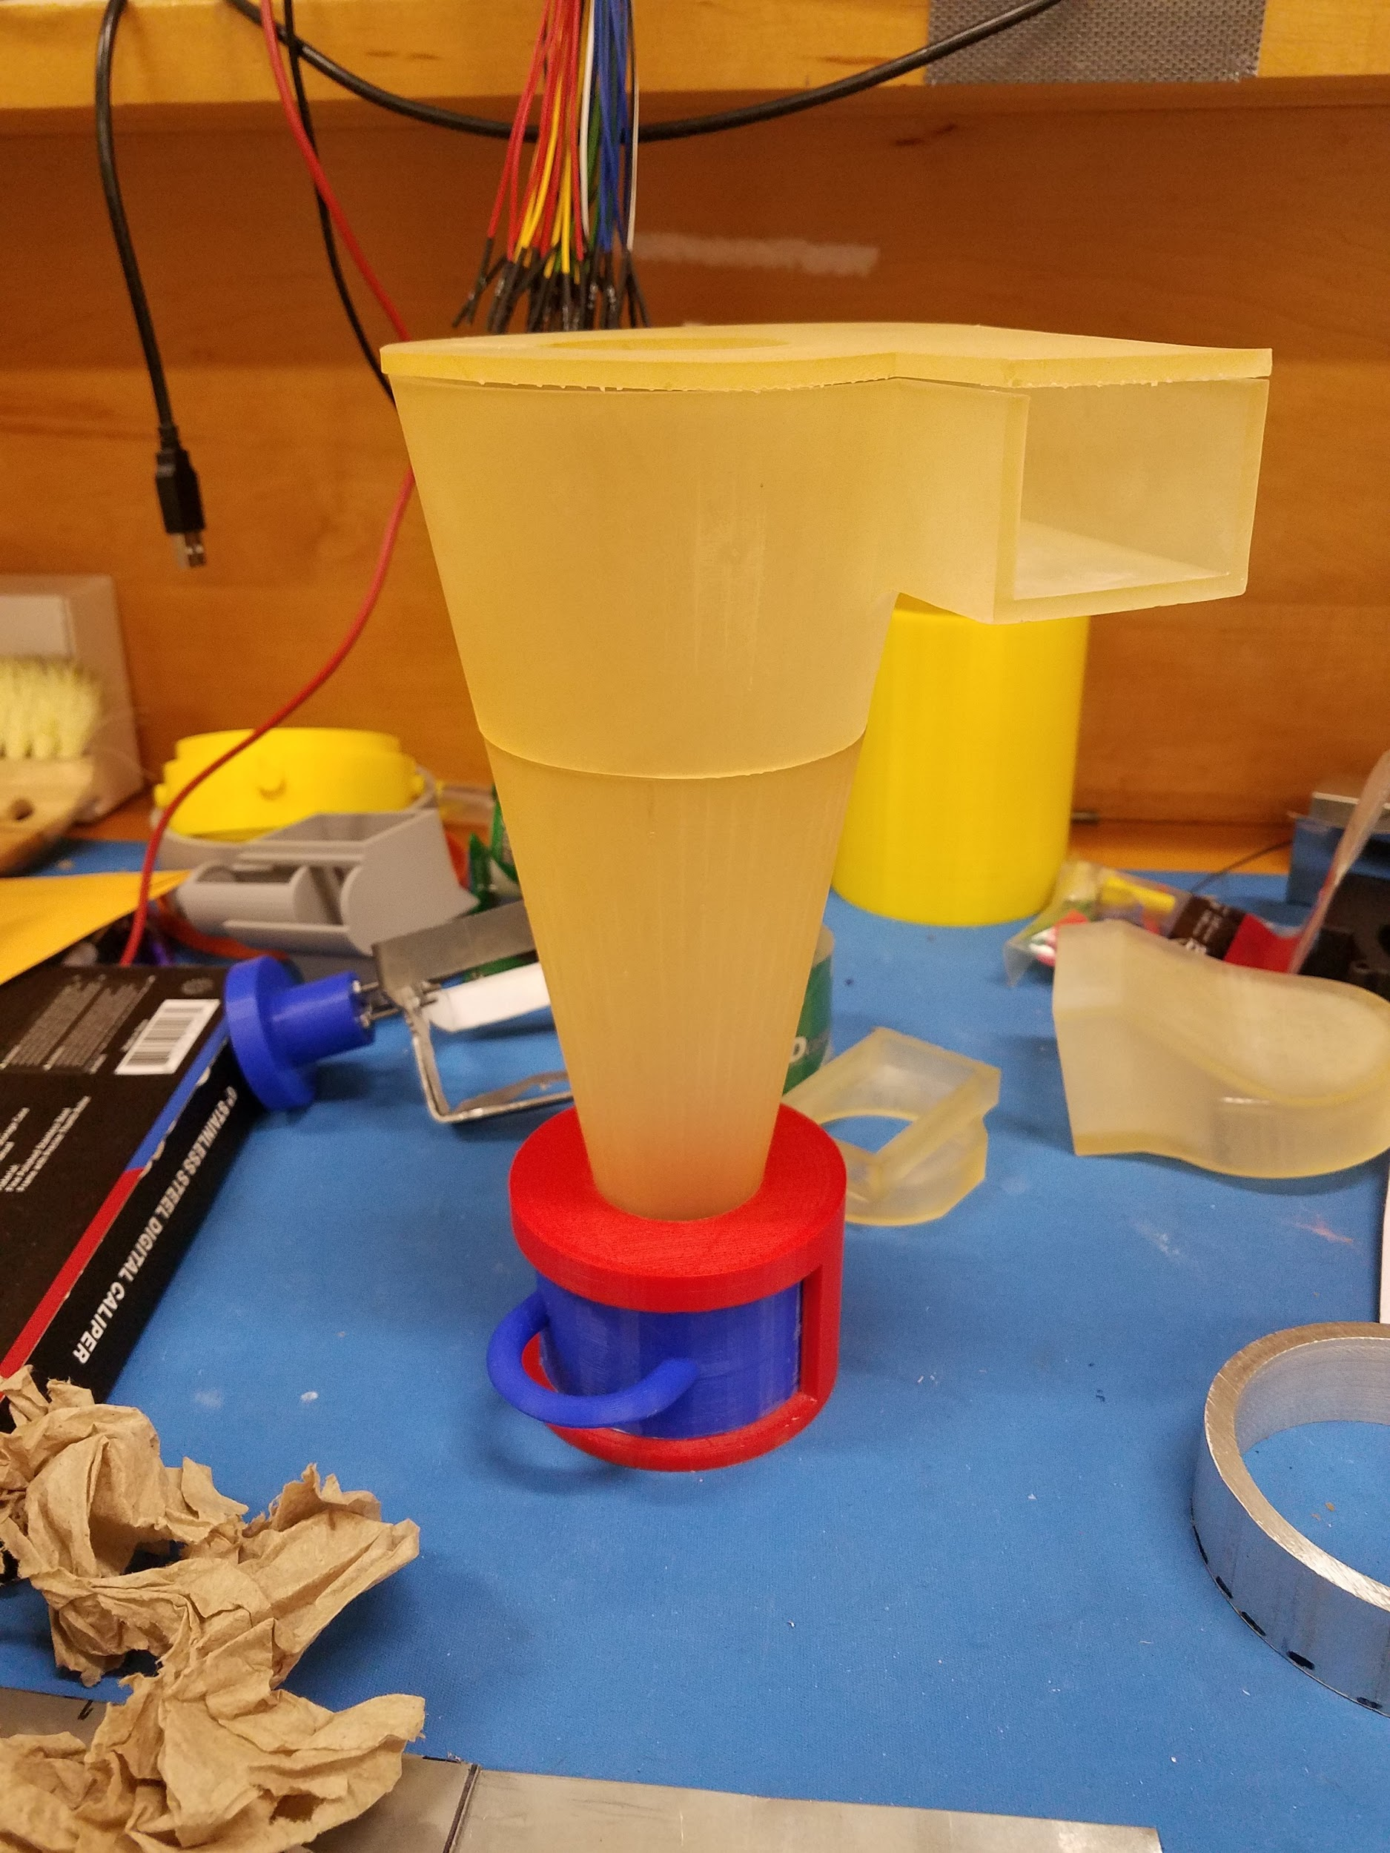
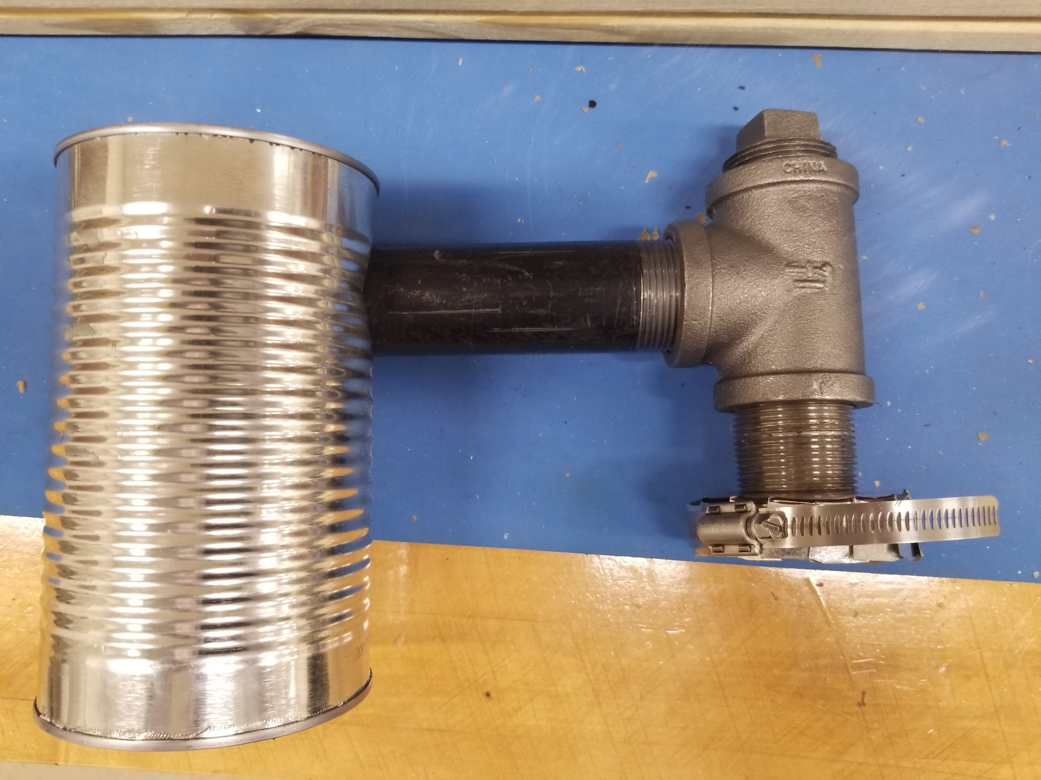
Chaff Collection
Design 1 Prototype
Design 2 Prototype
Notes:
Drake

Slide 14
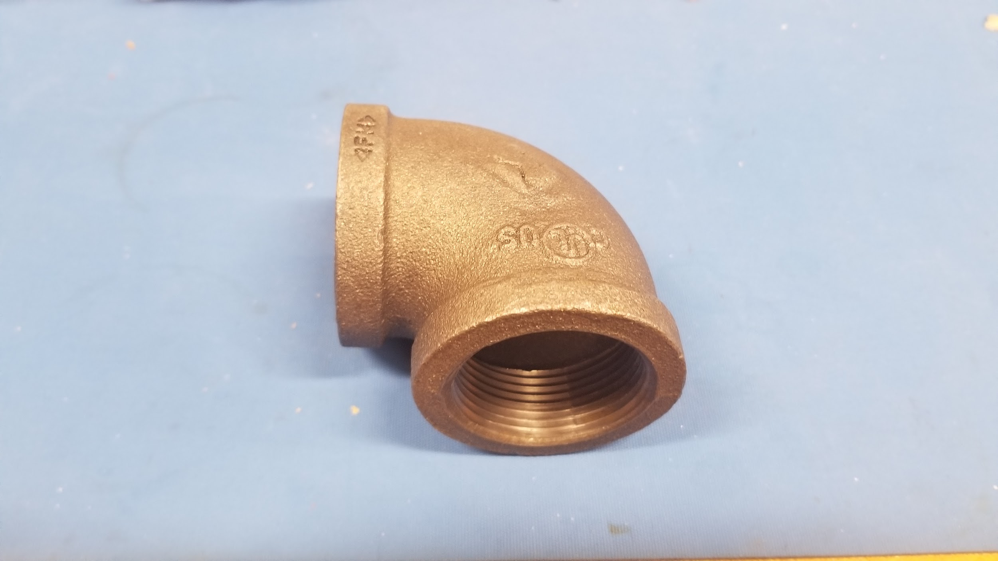
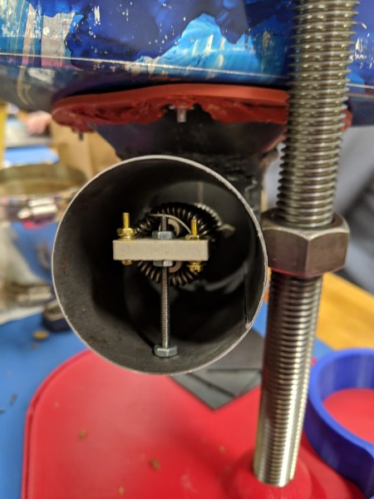
Heat Testing
Black iron piping used for Design 1 prototype
Black iron proved to be inefficient for heat transfer
Thinner metal piping used for Design 2
Will allow for greater heat transfer resulting in more beans being roasted at once
Talk about using thinner piping to reduce heat loss to materials, likely be able to reach higher temps and thus roast more than 120 beans
Notes:
Becca
For Design 2 we decided to continue to use the same model heating element used in the design 1 prototype. For more efficient heat transfer from that element we will not be using the black iron piping used in design 1. We discovered that the black iron piping was too think and as a result, was absorbing much of the heat that could be delivered to the roasting chamber. In design 2 we decided to used thinner metal piping made out of steel which provides more efficient heat transfer and therefore allows a more beans to be roasted.

Slide 15
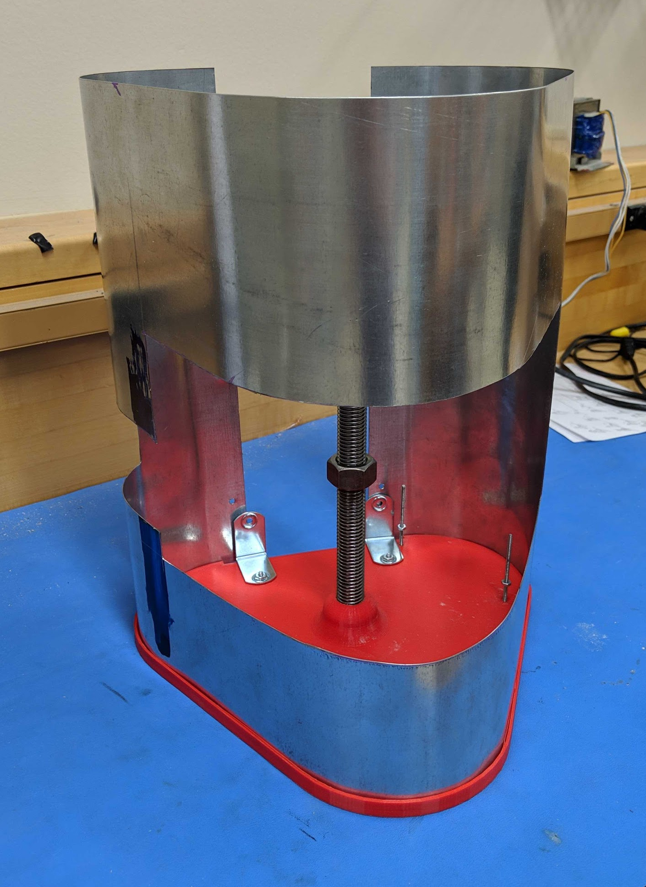
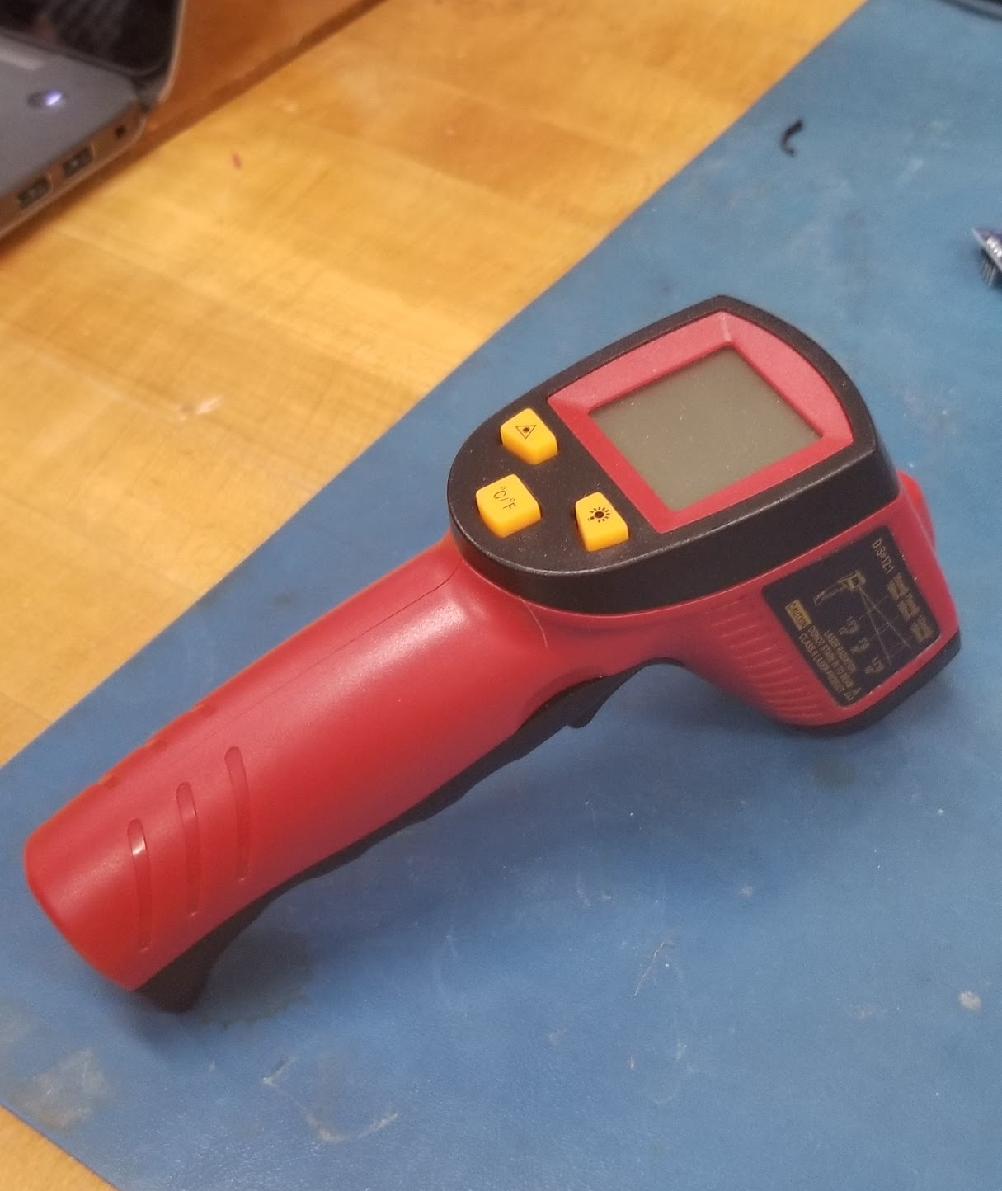
Surface Temperature testing
Must be below 60°C throughout the system
Test metal enclosure and interactable components using infrared thermometer
In-Progress: Perform airflow testing before surface temperature testing
Talk about using thinner piping to reduce heat loss to materials, likely be able to reach higher temps and thus roast more than 120 beans
Notes:
Becca
For Design 2 we decided to continue to use the same model heating element used in the design 1 prototype. For more efficient heat transfer from that element we will not be using the black iron piping used in design 1. We discovered that the black iron piping was too think and as a result, was absorbing much of the heat that could be delivered to the roasting chamber. In design 2 we decided to used thinner metal piping made out of steel which provides more efficient heat transfer and therefore allows a more beans to be roasted.

Slide 16
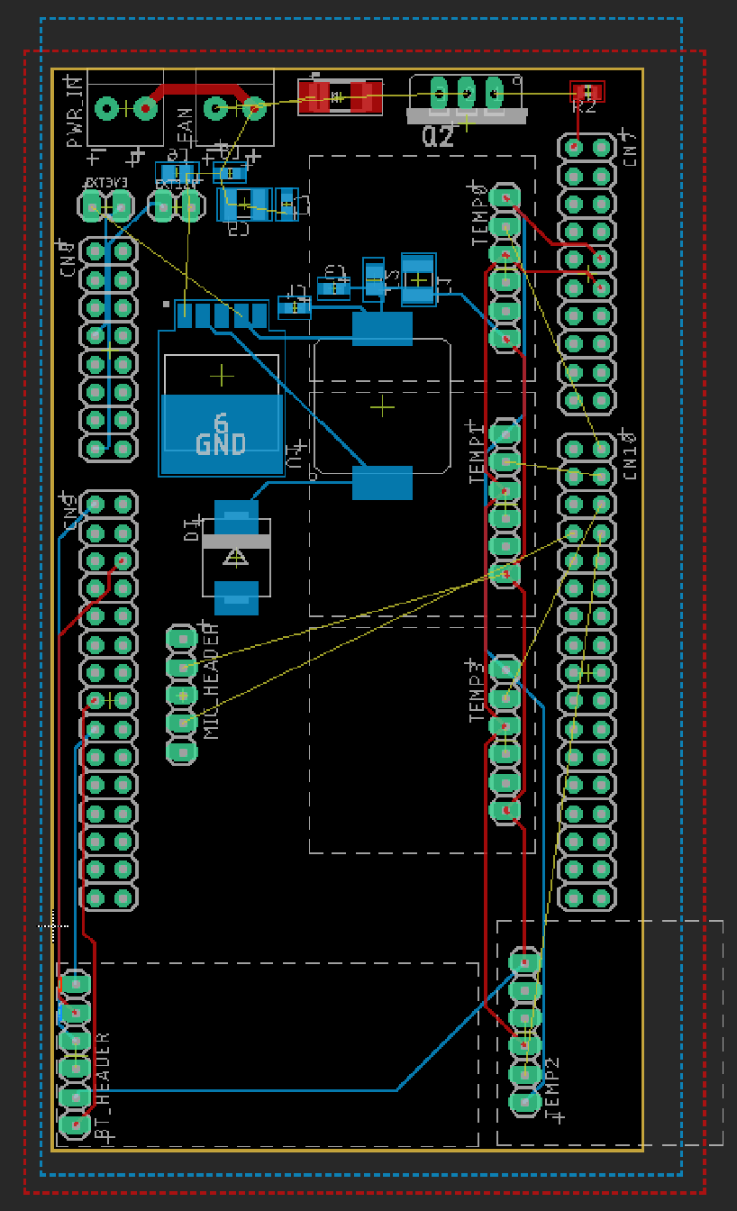
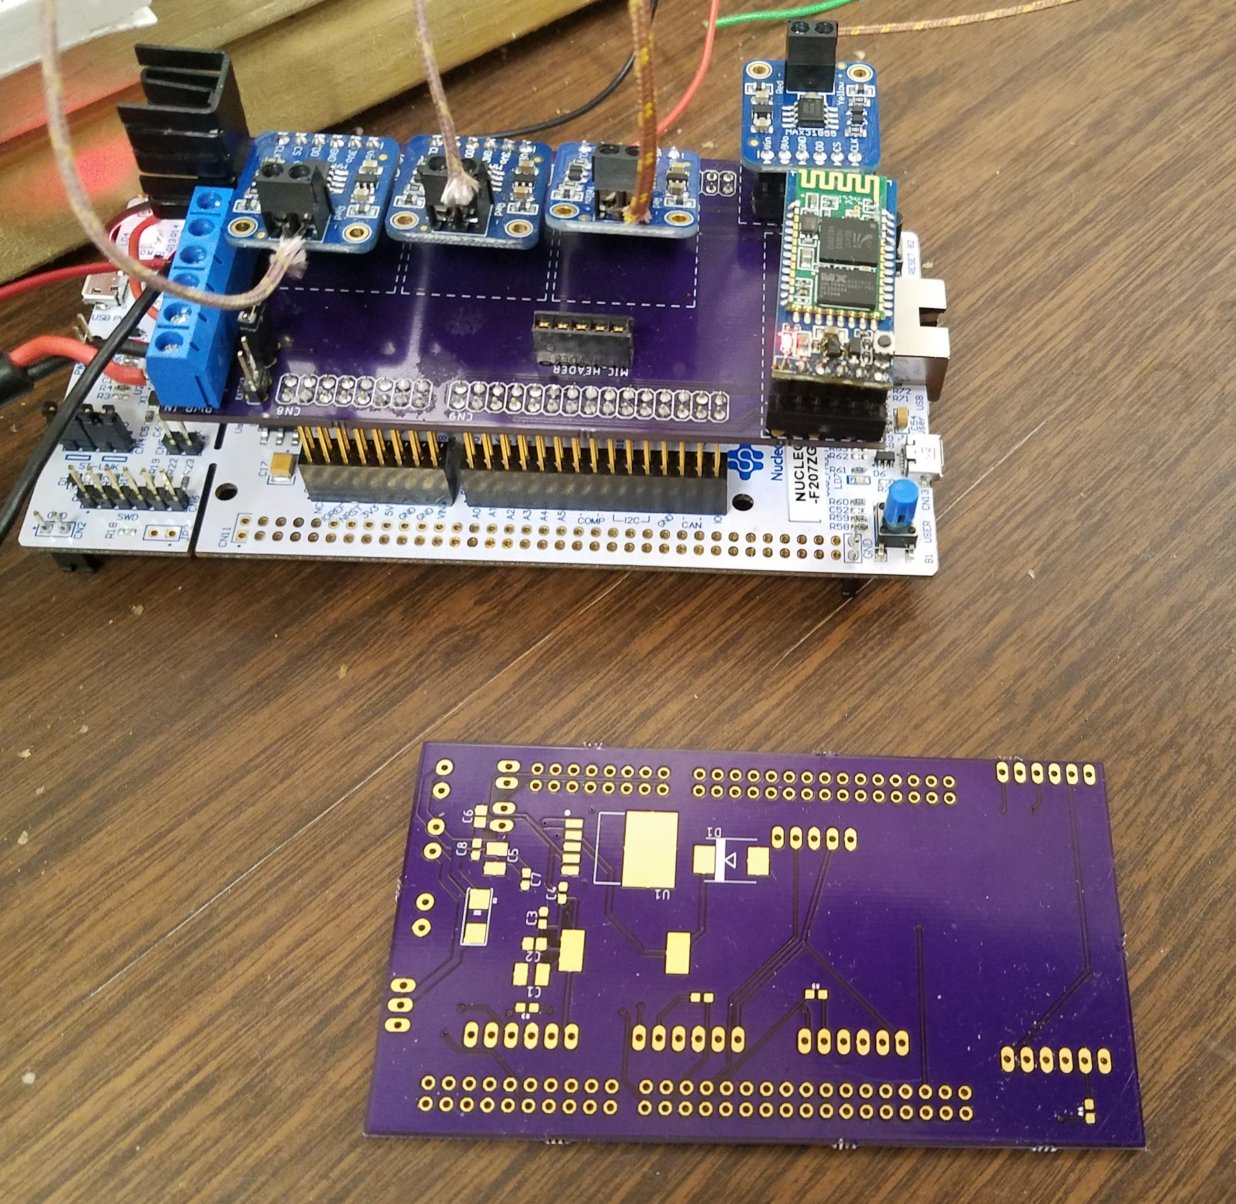
PCB
PCB Layout
Testing PCB
Notes:
Becca
-PCB designed to replace breadboard
-interfaces directly to dev board for easy troubleshooting
-built in power regulation for 12V to 3.3V
-Fan driver also added

Slide 17
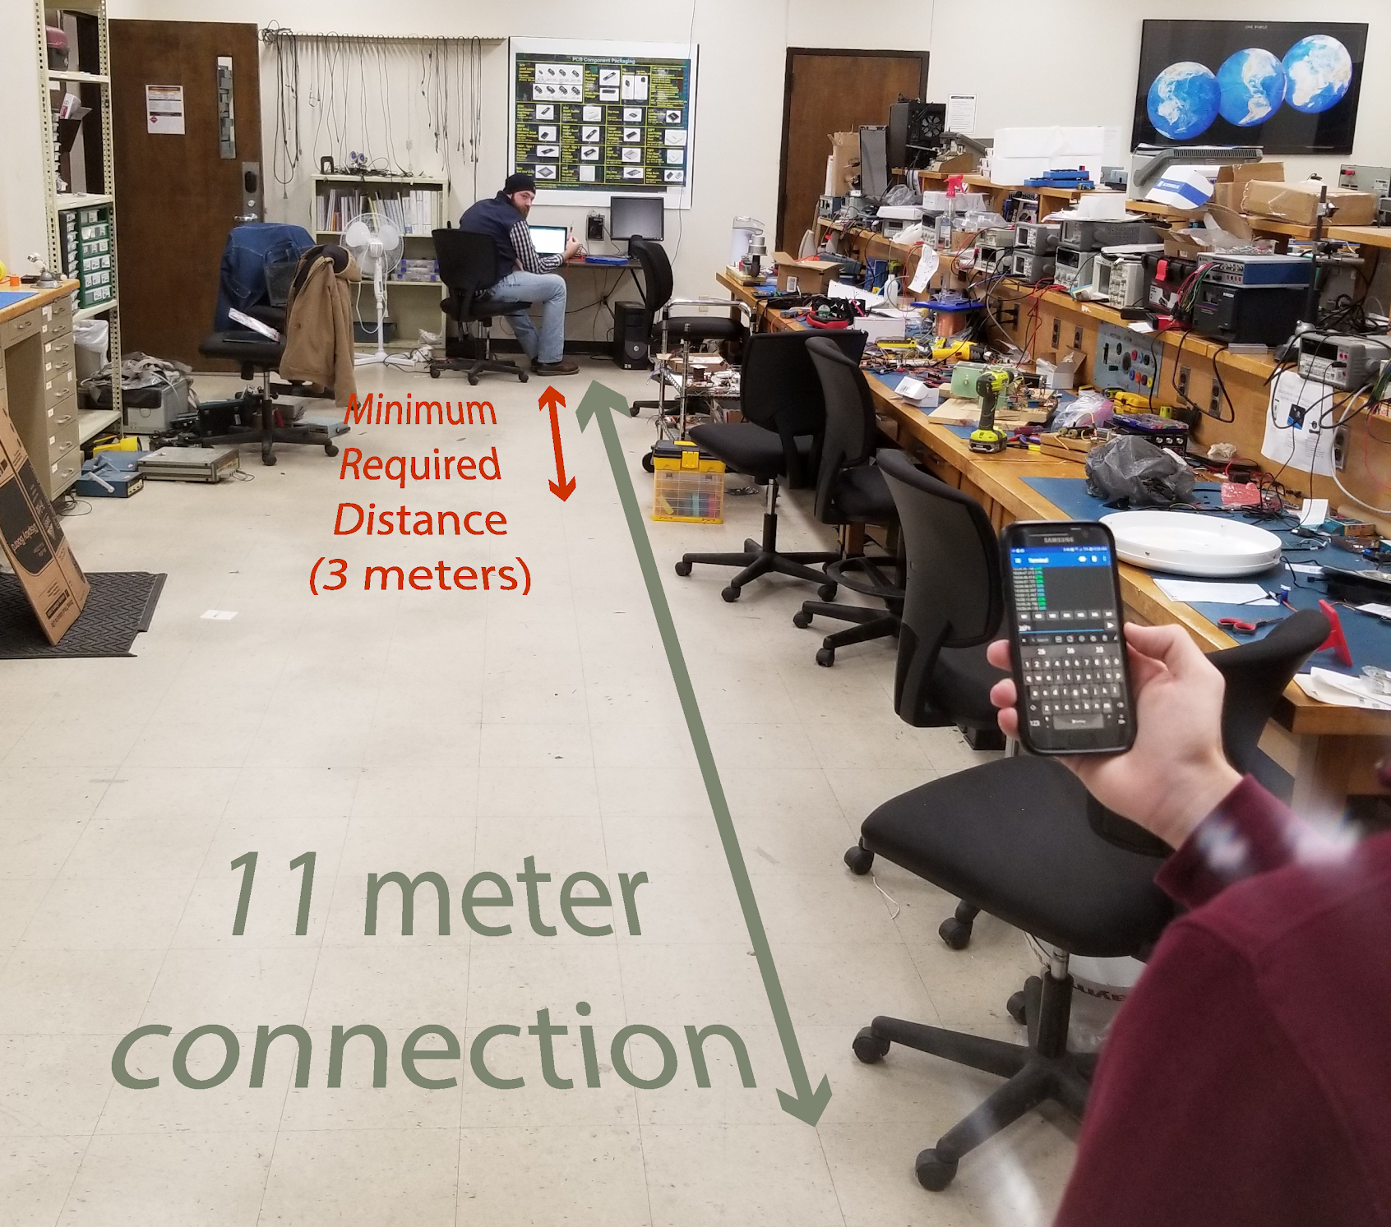
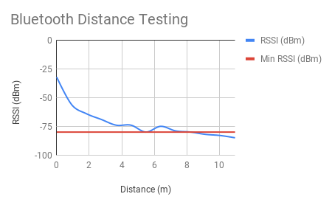
Wireless Comms
Notes:
Chaise

Slide 18
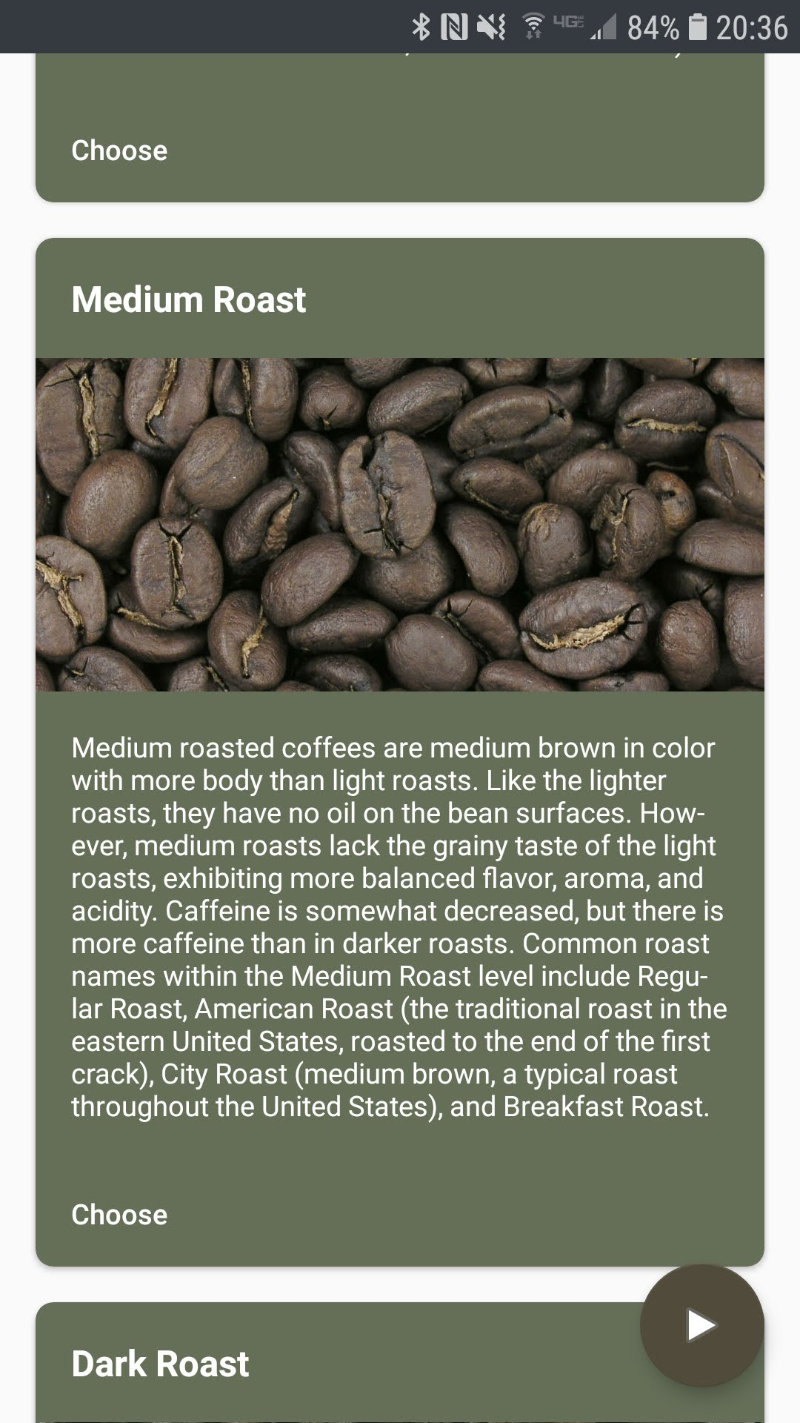
Phone App
Roast Details
3 Roast Profiles
Manual Mode
Notes:
Noah
Our current smartphone app allows the user to view roast details during a roast, choose from 3 roast profiles, and manually control the fan or heating element power. We plan to revamp this a little and add in the ability to create a custom roast from scratch.

Slide 19
Phone App (cont.)
Home page
Click “+” on home page
Add Bean menu
Roast Details
Notes:
Noah
Looking past senior design, here are some mockups of a V2 of the app with a complete redesign. This will allow the user to select from many pre-defined roasts and customize them to their liking, as well as create their own roasts.

Slide 20
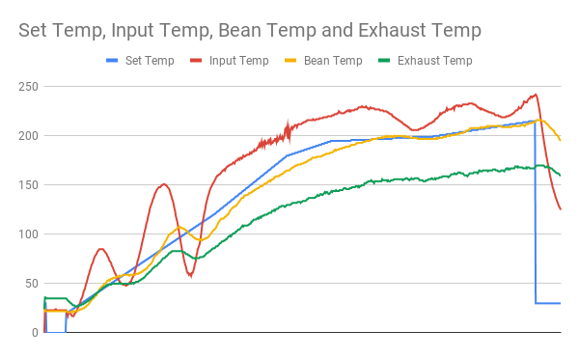
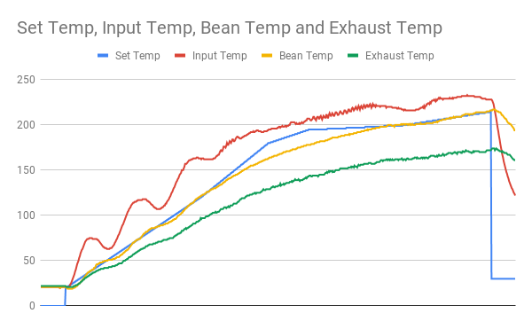
Full System Test
Before PID Tuning
After PID Tuning
Notes:
JR
Set temp in red is closely matched by bean temp (matching defined roast profile)
Rate of rise is the goal of a manual machine as local roaster
Computer control results in a smooth rate of rise

Slide 21
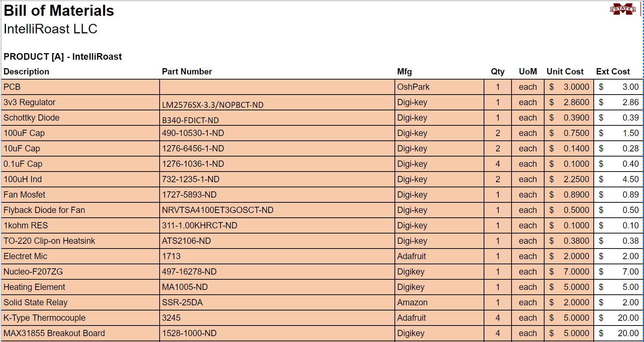
Bill of Materials: Electrical

Slide 22
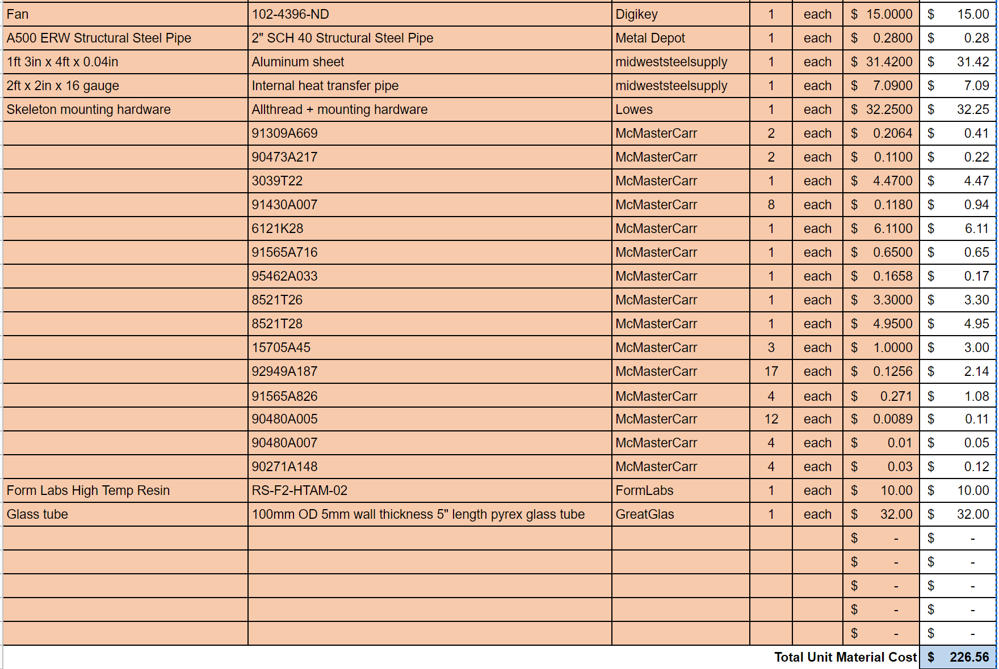
Bill of Materials: Mechanical

Slide 23
References
[1] “Maxwell House,” Recipes. [Online]. Available: http://www.kraftrecipes.com/maxwell-house. [Accessed: 02-Oct-2018].
[2] “Folgers Coffee - The Best Part of Wakin' Up | Folgers Coffee,” History | Folgers Coffee. [Online]. Available: https://www.folgerscoffee.com/. [Accessed: 02-Oct-2018].
[3] “Single Serve Coffee Makers & K-Cup Pods | Keurig®,” Keurig® Coffee Makers | Best Single Cup Coffee Machines. [Online]. Available: https://www.keurig.com/. [Accessed: 02-Oct-2018].
[4] “Roasting coffee beans in a wok on a kitchen stove top”, Wikipedia. [Online]. Available: https://commons.wikimedia.org/wiki/File:Wok_down_angle.jpg. [Accessed: 15-Nov-2018].
[5] L. Wallender, “Average Kitchen Size? Well, It's Complicated...,” The Spruce. [Online]. Available: https://www.thespruce.com/average-kitchen-size-1822119. [Accessed: 24 Sep. 2018].

Slide 24
IntelliRoast
Chaise Farrar · Drake Bolland JR Jamora · Noah Siano Rebecca Siciliano
Notes:
Chaise
Hello, Thank you for being here today. We are IntelliRoast and we have been graciously sponsored by Kopis Mobile. To begin...

