Slide 1

IntelliRoast
Chaise Farrar · Drake Bolland JR Jamora · Noah Siano Rebecca Siciliano
Notes:
Chaise
Hello, Thank you for being here today. We are IntelliRoast and we have been graciously sponsored by Kopis Mobile. To begin...

Slide 2





Introduction: Team Members
Chaise Farrar
Computer Engineering
Embedded Design
Team Lead
Drake Bolland
Electrical Engineering
Mechanical Design
Electrical Design
JR Jamora
Electrical Engineering
Thermodynamic Modeling
Electrical Design
Noah Siano
Computer Engineering
Application Development
Website Development
Rebecca Siciliano
Electrical Engineering
Thermodynamic Modeling
Electrical Design
Notes:
Everyone

Slide 3

Introduction: Faculty Advisor
Dr. Masoud Karimi
Associate Professor, Mississippi State University
Ph.D., Electrical Engineering, Energy Systems, University of Toronto, Canada, 2004
Power system stability, protection and control
Notes:
Drake
Power system stability, protection and control Power system stability, protection and control Power system stability, protection and control Power system stability, protection and control Power system stability protection and control, Power system stability, protection and control Power system stability, protection and control Power system stability, protection and control Power system stability, protection and control Power system stability, protection and control Power system stability, protection and control, Power system stability, protection and control

Slide 4

Outline
The Problem
The Solution
Constraints
  Technical Constraints
  Practical Constraints
  Engineering Standards
Approach
Overview
Constraints
Present Work
Future
Notes:
JR
Our outline for today is to discuss the problem at hand within the coffee industry and our solution for these problems. We will then discuss how IntelliRoast aims to solve these issues, with an emphasis on our established requirements we are constraining IntelliRoast and the vision set out for IntelliRoast through our approach.

Slide 5


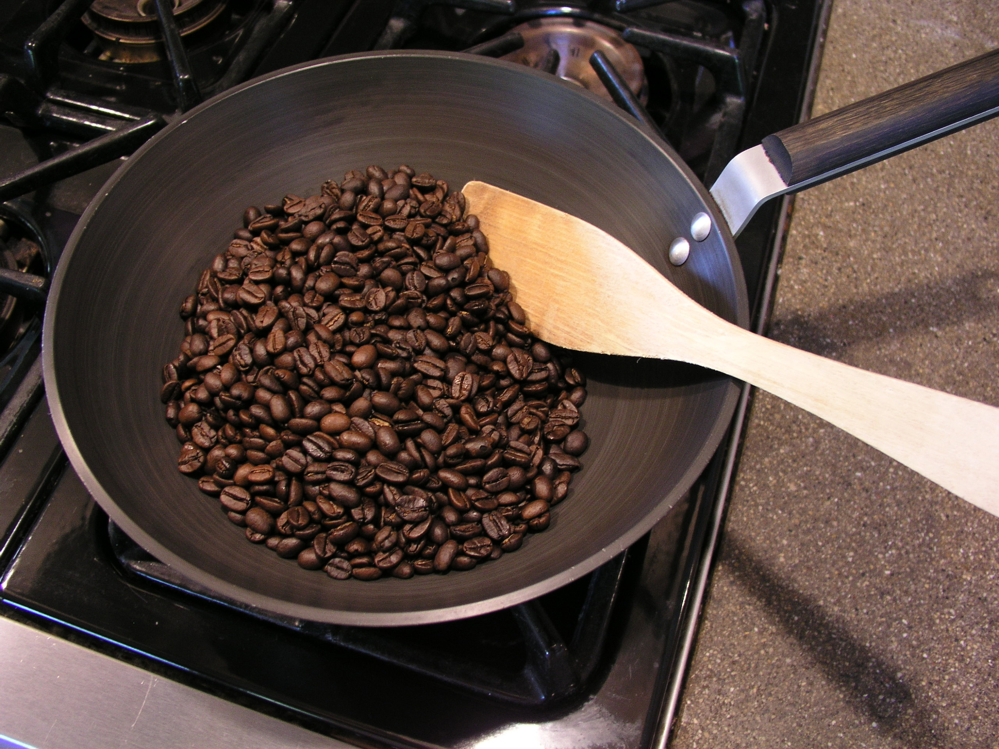

Problem
[1], [2], [3], [4]
Notes:
Chaise
So what is the problem IntelliRoast addresses? It starts with brands like these. They have allowed coffee to become one of the most popular beverages in the world, at a cost. The coffee they provide is low grade, over roasted, and stale, in most cases, by many months. This in contrast to buying coffee from local roasters who provide high quality, fresh roasted coffee. This coffee though comes with a premium price that many can’t justify.

Slide 6


Solution
Notes:
Becca
Roasting your own beans at home is a way of solving this coffee nightmare. By roasting at home, beans are insured to be fresh and roasted to the profile a user wants every time. IntelliRoast is a household kitchen appliance that does just that. It interfaces with an app allowing the user to pick their roasting profile and have a hands free roasting experience at home. To do this we have outlined some constraints on our design.

Slide 7
Technical Constraints
Constraint | Description
Power Draw | Under 15A at 120V
Bean Agitation | Agitate and lift ~120g of beans
Roasting Temperature | At least 300°C
Surface Temperature | Must not exceed 60°C
Wireless Distance | Connect up to 3 meters away [5]
Notes:
Drake

Slide 8
Practical Constraints
Constraint | Description
Economic | Cost less than $500
Hands-Free Usage | Operate without user intervention
App-Enabled | Additional features in smartphone app
Chaff Collection | Collect chaff
Notes:
Noah
IntelliRoast will also need to meet some practical constraints. The device will cost less than $500. There are some similar products already on the market, but those start at $1600, so we wanted to choose a price to allow the everyday consumer to buy this for their home. Also, IntelliRoast will roast coffee without the user having to step in during the process. They just start the roast and IntelliRoast does the rest. This is a key feature, since even the industrial roasters manually control temperatures and roast times for each roast. Additionally, users can use a smartphone app to choose different roasts and view roast progress. Our final practical constraint is chaff collection. Chaff is a paper like substance that flakes off of the coffee beans during the roast, and it is both a nuisance to the consumer and a fire hazard, so IntelliRoast must collect the chaff and keep it separate from the roasted beans.

Slide 9
Engineering Standards
Standard | Description
ASTM C1055 | The surface temperature must be below 70°C
IEC-60529 | Abide by IP ratings to protect against the intrusion of solid objects and water
Notes:
JR
On top of our established constraints, these are the engineering standards IntelliRoast will comply. The ASTM standards establish upper temperature limits where the device transitions from “safe to touch” to “first degree burn risk.” The defined standard is 70 C, which is higher than our established 60 C constraint. This was designed to further protect the user from burns.
The IEC standards define a device’s protection from solid objects and water, which

Slide 10
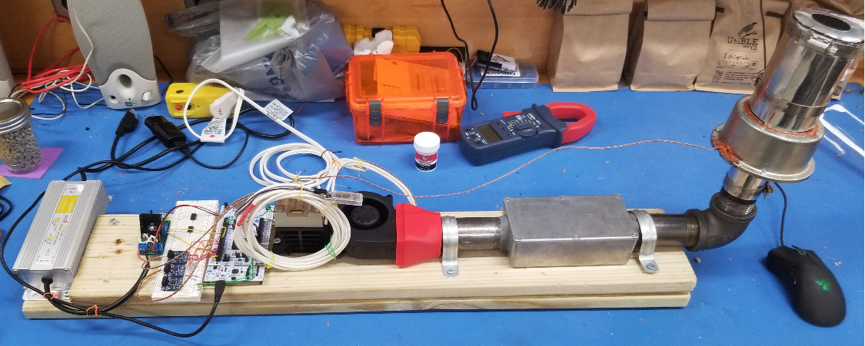
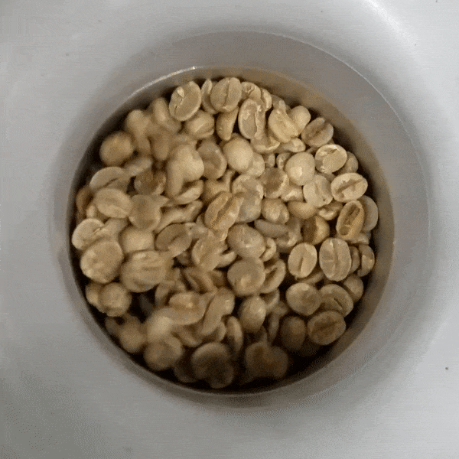
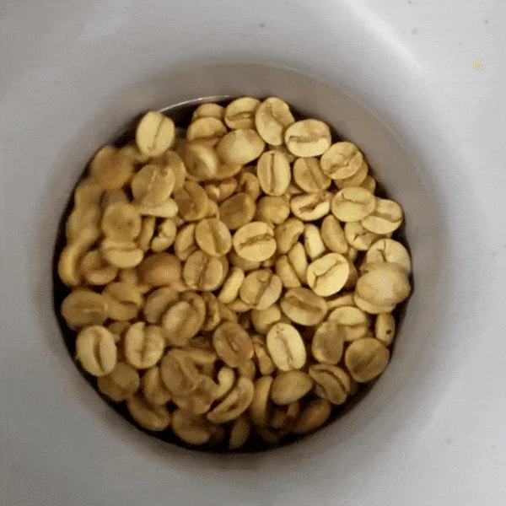
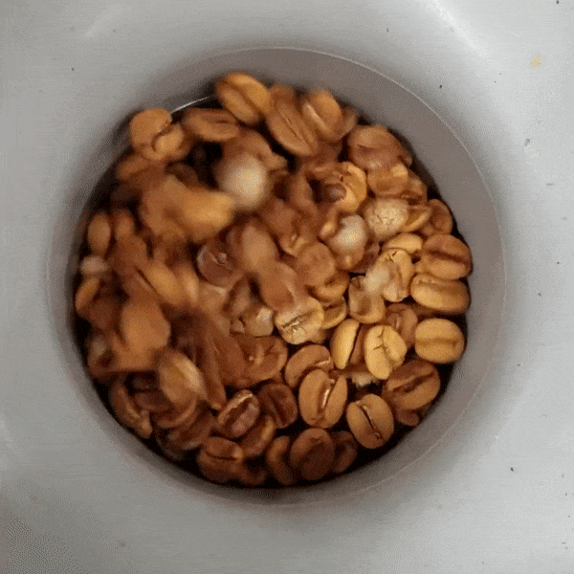
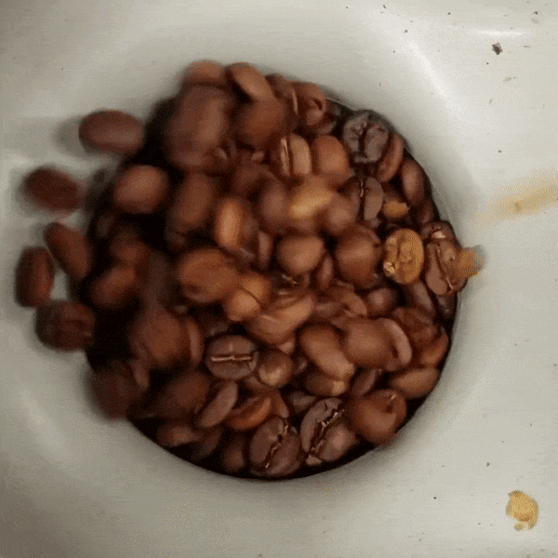
Prototype Overview
Notes:
JR

Slide 11
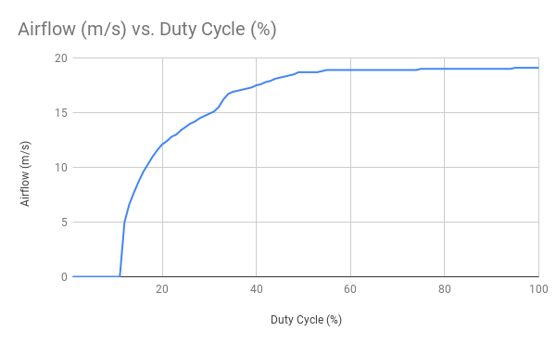
Bean Agitation
Duty Cycle (%) | Bean Agitation
15 | No
25 | Minor
30 | Moderate
35 | Yes
Notes:
Chaise

Slide 12
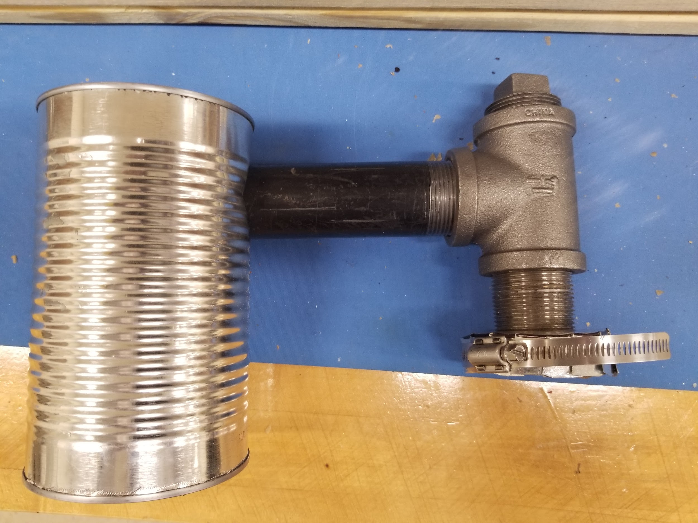
Chaff Collection
Notes:
Drake

Slide 13
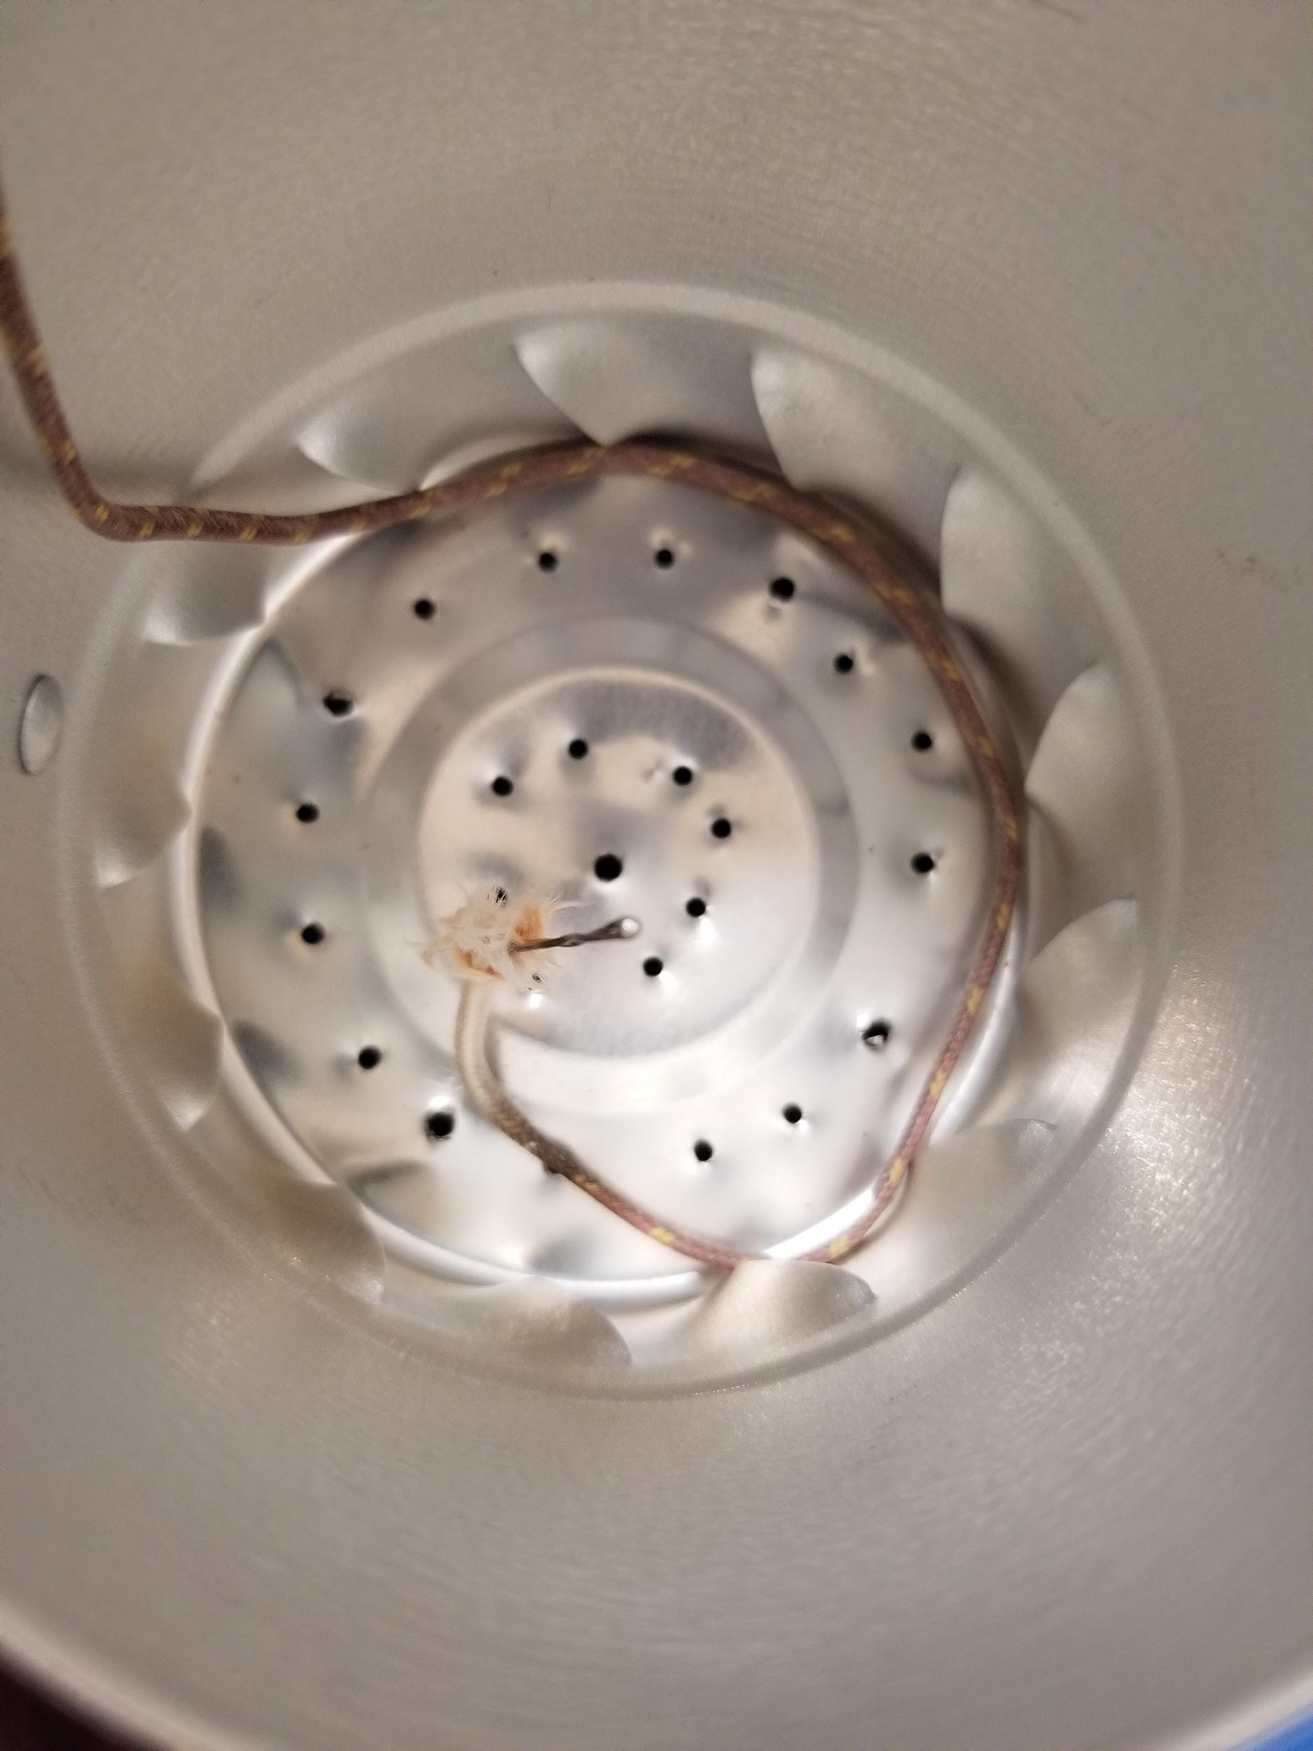
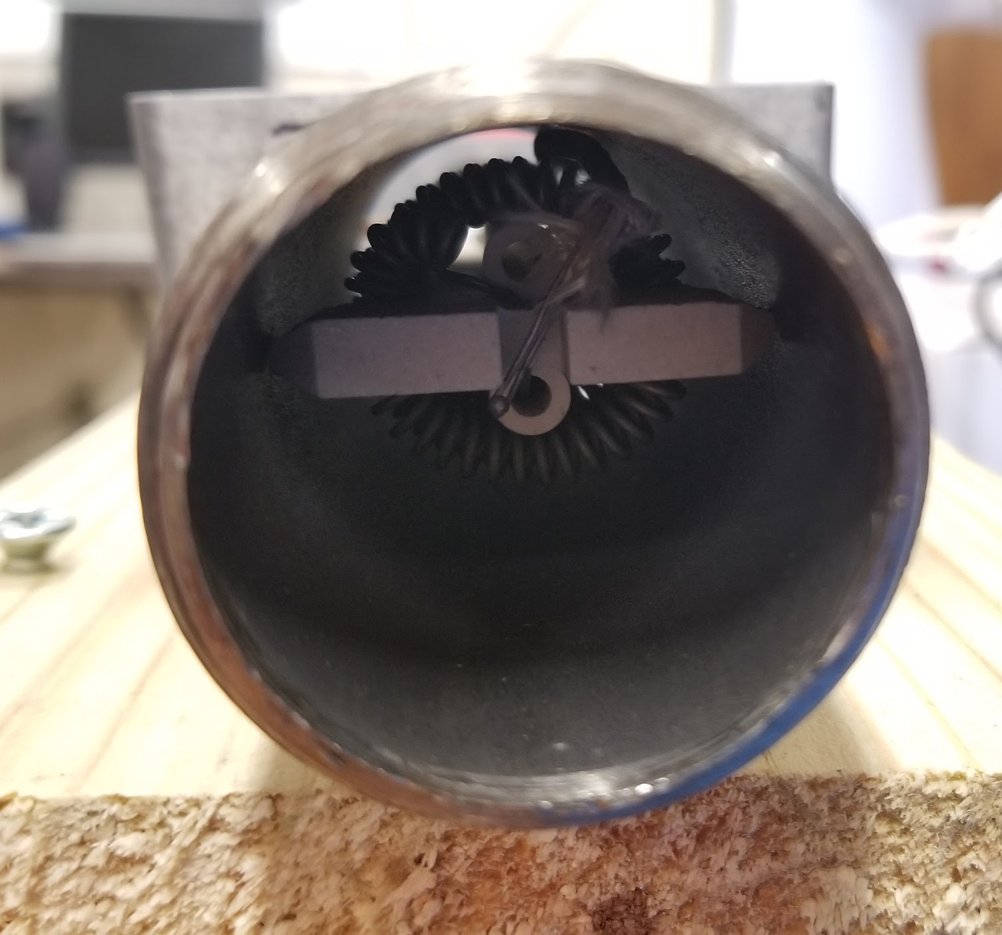
Heat Testing
Thermocouples
Notes:
Becca
We began heat testing by first testing the operation of the heating element. Once we confirmed the part worked as expected, we mounted it inside an aluminum box connected with black iron piping to the fan. The heating element was then tested with the fan blowing ambient air over the element. A thermocouple was mounted near the coils of the element to read the temperature change before and after the fan was introduced. A thermocouple was also mounted inside the roasting chamber to read the temperature change during the roasting process.

Slide 14
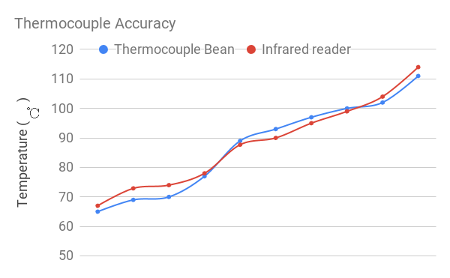
Heat Testing (cont.)
Notes:
noah

Slide 15
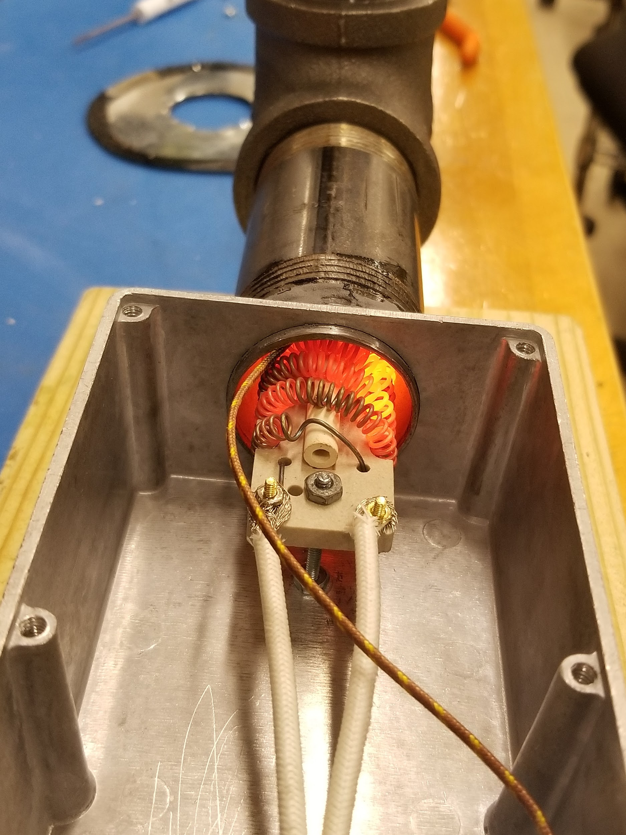
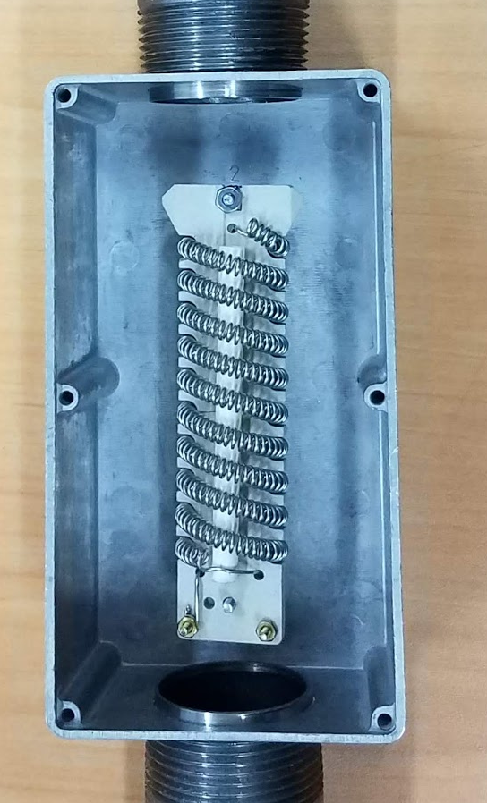
Heat Testing (cont.)
Assembly Progress:
Heating element mounted in the box
Fan connected with piping
Thermocouples mounted inside heating element and roasting chamber
Tests:
Heating with thermocouple inside element
Heating with fan to test thermocouple output
Insulation
Notes:
Becca
We noticed while the heating element was mounted in the box and as we increased the element temperature, there was a small change in temperature of the air we were heating. We moved the element inside the iron piping, rather than the box to restrict the volume of air passing over the element. We have ~54% improvement. We then noticed a better efficiency once we did this.
bean ~70
Before 428
After 230
Before: 340 - 63
After: 230 - 77

Slide 16
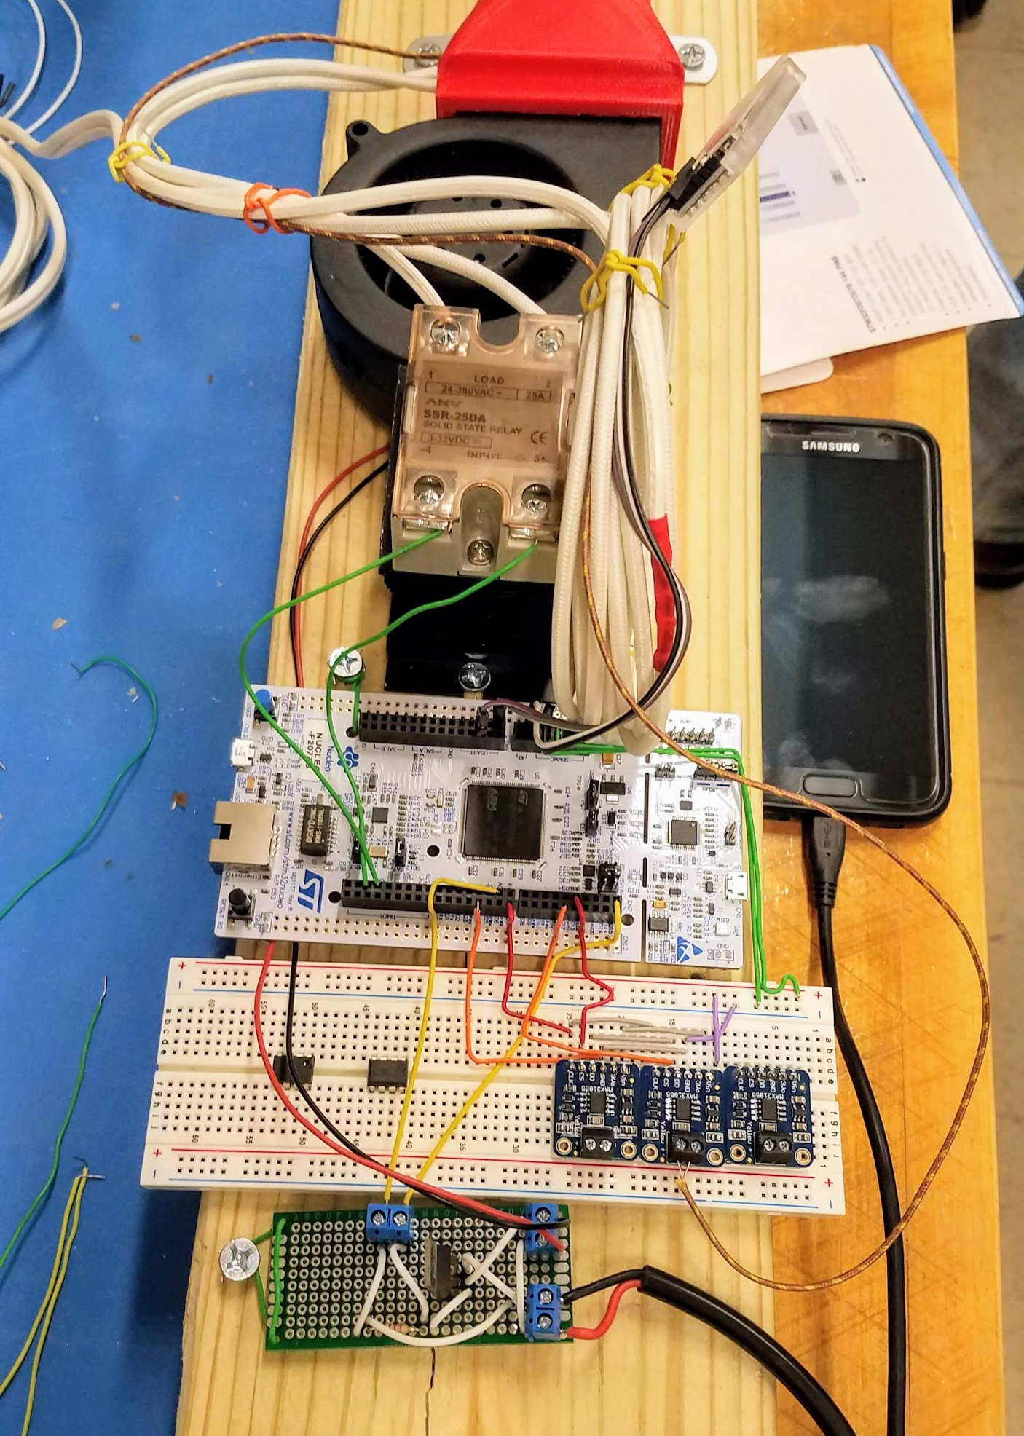
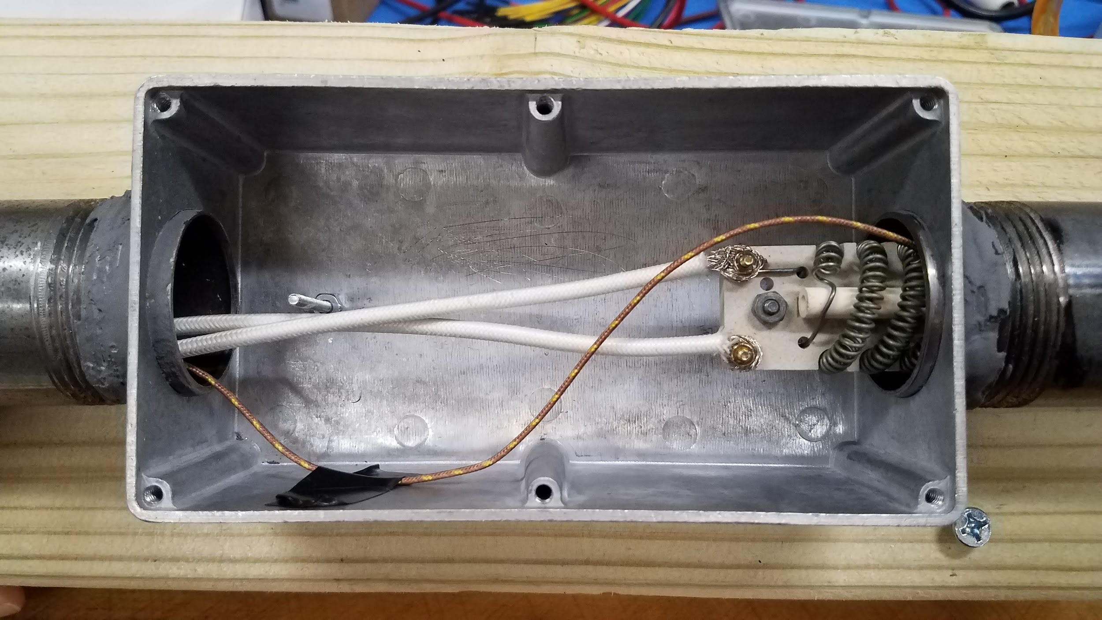
Wiring
Notes:
chaise

Slide 17
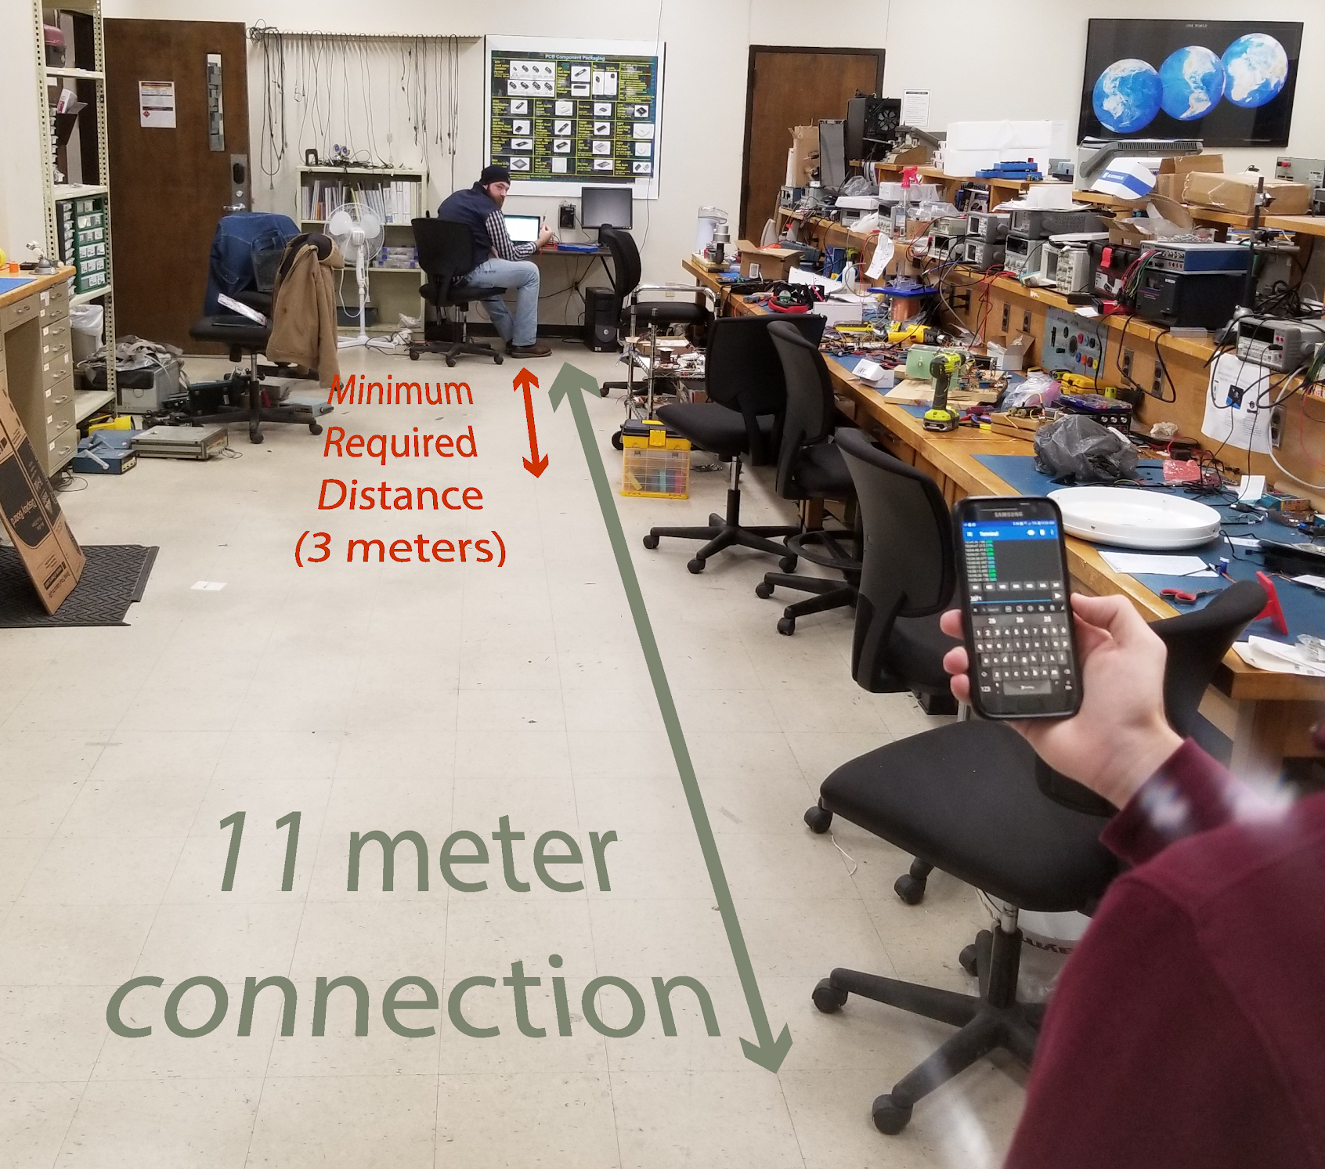
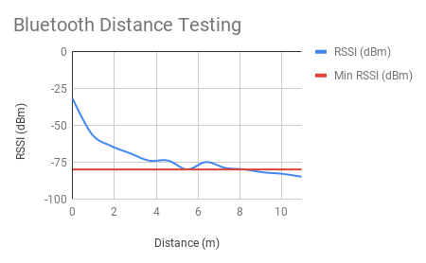
Wireless Comms
Notes:
Chaise

Slide 18
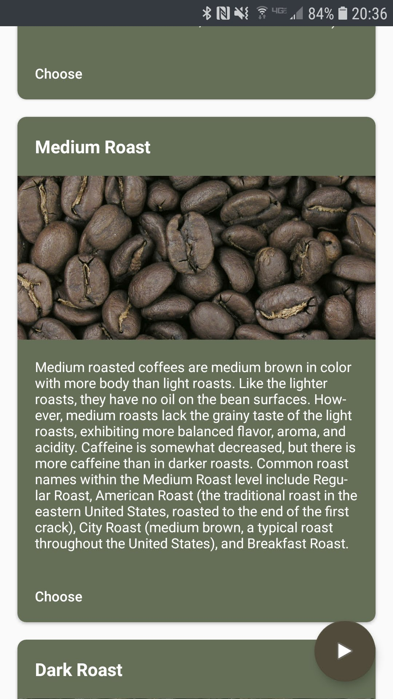
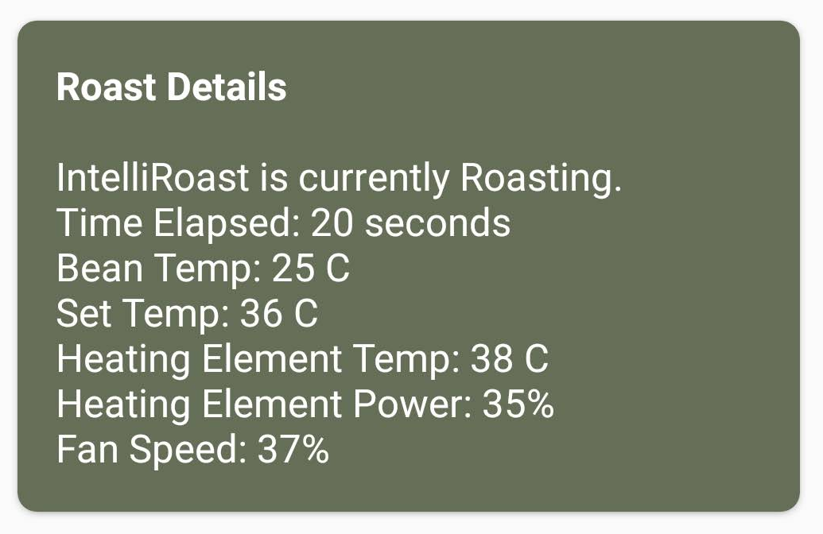
Phone App
Roast Details
Manual Mode
3 Roast Profiles
Notes:
noah

Slide 19
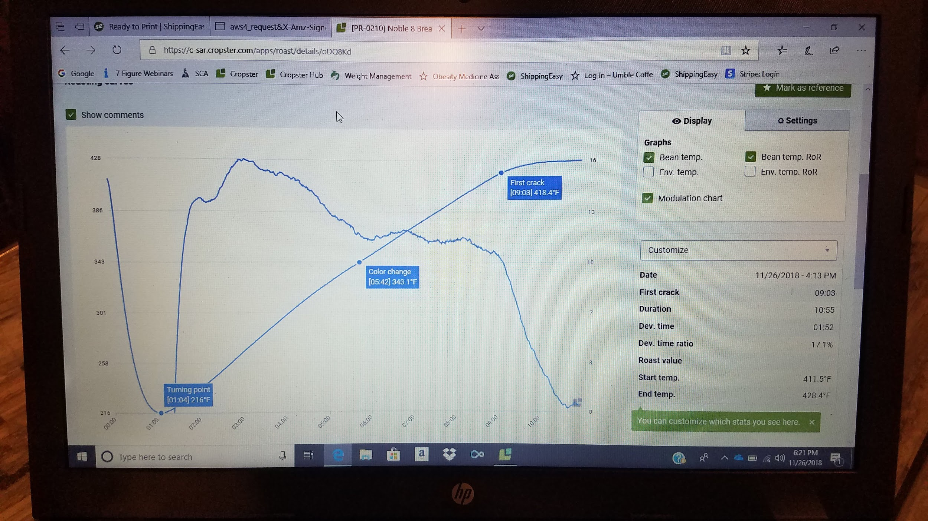
Full System Test
Notes:
JR
Roast done by a professional roaster this week

Slide 20
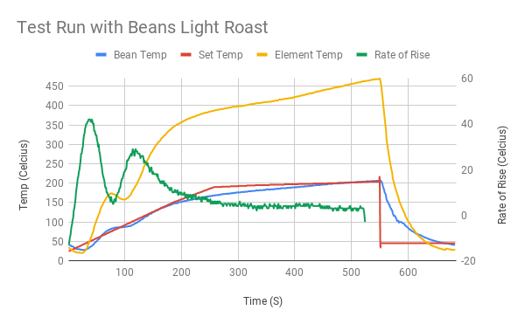
Full System Test
Notes:
JR
Set temp in red is closely matched by bean temp (matching defined roast profile)
Rate of rise is the goal of a manual machine as local roaster
Computer control results in a smooth rate of rise

Slide 21
Future Plans
Finish Chaff Collection System
Further Refine Roast Profiles
Notes:
JR
Not implemented on app or microcontroller (next week)
Chaff collection - model chaff collector, quick testing w/ prototypes
Fan Control - have heating element controlled with microcontroller. Fan is currently manual
Full system - microcontroller to turn things on - still need fan/chaff/heating to work
App is currently not final product, does not have roast profiles, bluetooth (mostly incomplete)
Heat resistant gaskets to seal up hot air leaks

Slide 22
References
[1] “Maxwell House,” Recipes. [Online]. Available: http://www.kraftrecipes.com/maxwell-house. [Accessed: 02-Oct-2018].
[2] “Folgers Coffee - The Best Part of Wakin' Up | Folgers Coffee,” History | Folgers Coffee. [Online]. Available: https://www.folgerscoffee.com/. [Accessed: 02-Oct-2018].
[3] “Single Serve Coffee Makers & K-Cup Pods | Keurig®,” Keurig® Coffee Makers | Best Single Cup Coffee Machines. [Online]. Available: https://www.keurig.com/. [Accessed: 02-Oct-2018].
[4] “Roasting coffee beans in a wok on a kitchen stove top”, Wikipedia. [Online]. Available: https://commons.wikimedia.org/wiki/File:Wok_down_angle.jpg. [Accessed: 15-Nov-2018].
[5] L. Wallender, “Average Kitchen Size? Well, It's Complicated...,” The Spruce. [Online]. Available: https://www.thespruce.com/average-kitchen-size-1822119. [Accessed: 24 Sep. 2018].

Slide 23
IntelliRoast
Chaise Farrar · Drake Bolland JR Jamora · Noah Siano Rebecca Siciliano
Notes:
Chaise
Hello, Thank you for being here today. We are IntelliRoast and we have been graciously sponsored by Kopis Mobile. To begin...

Slide 24


